Slide 1
Muslims and Islam
KS1 Barrington Primary School

Slide 2
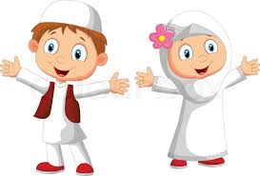
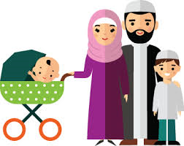
Religion of Islam
What do you think Religion is?
People who follow the religion of Islam are called Muslims
Muslims believe in 5 pillars

Slide 3
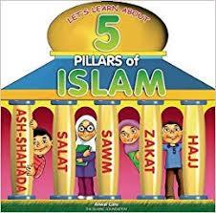
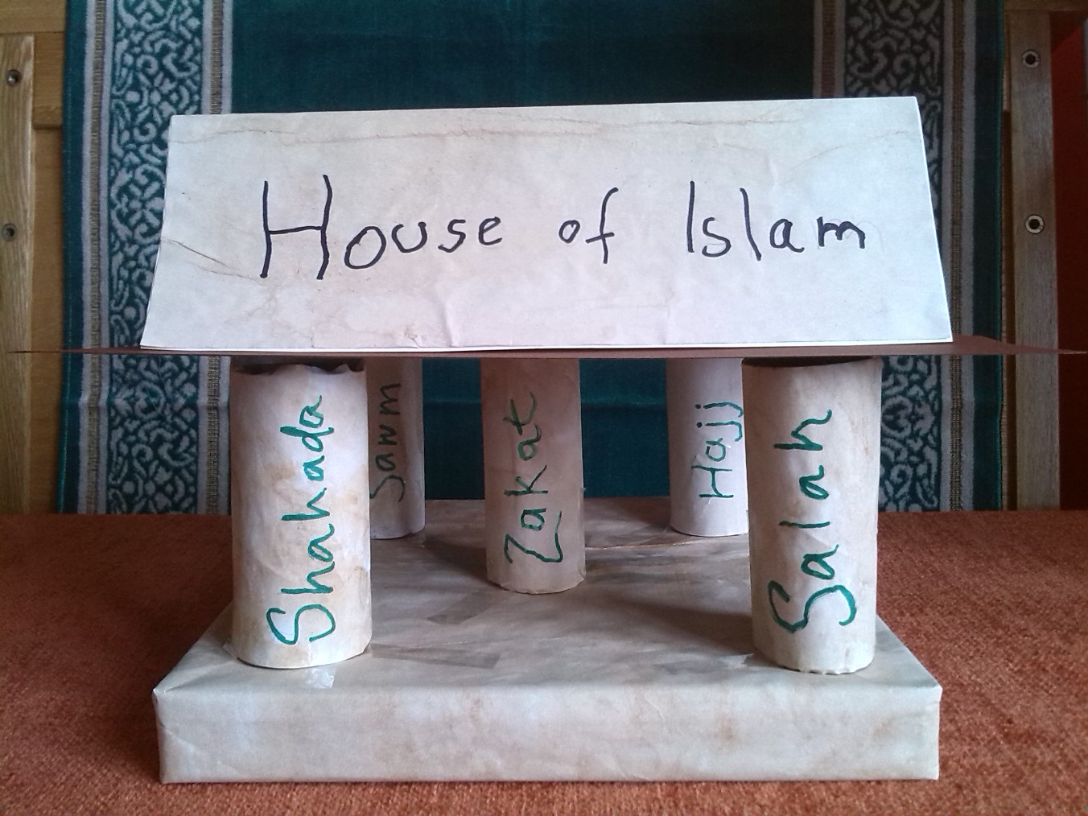
5 Pillars
Every house needs some Pillars which hold the roof.
  They support the house. Without Pillars the house will fall.
If we think of Islam as a house, it has five pillars
  that support the house of Islam.

Slide 4
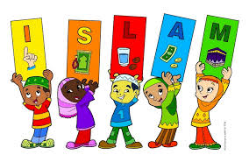
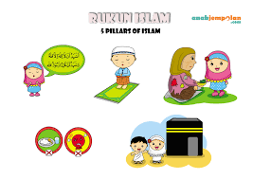
5 Pillars
Shahada
  There is one God called Allah and Prophet Mohammed is the last prophet
Salah – Praying 5 times a day
Sawm – Fasting at special Month
Zakat – Giving Charity
Hajj - Visiting Mecca

Slide 5
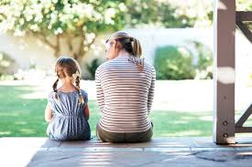
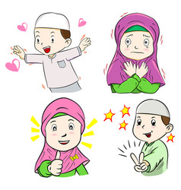
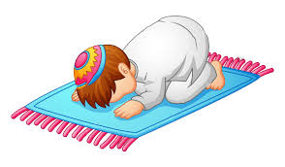
Salah – Prayer
Do you have a special person or time to think about things and talk ?
When people Pray – who do you think they are talking to?
Muslims Pray 5 times during the day – where they connect with God
They Praise him, show gratitude, talk about what makes them happy, sad or ask for help.

Slide 6
Salat – Wudu
Before you talk to someone special – do you make extra effort?
Before Muslims pray they must do something called Wudu.
During wudu, you rinse your mouth, nose, wash your face, arms and feet.

Slide 7
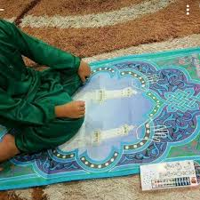
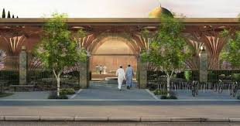
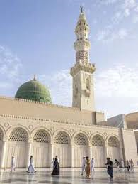
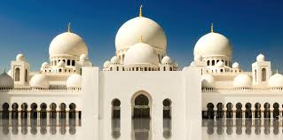
Where do you preform Salah ?
Do you have a special place in your house?
Muslims can Pray Salah at home – and use the prayer mat
Muslims also pray in groups in Mosques
Mosques are places where at time of Salah people come together to Pray
There are several Mosques around the world and in Cambridge

Slide 8
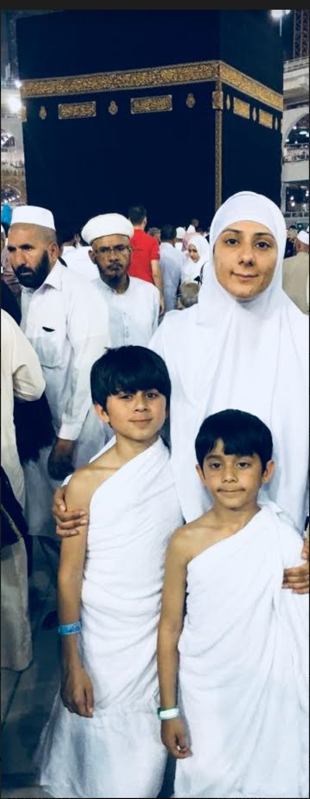
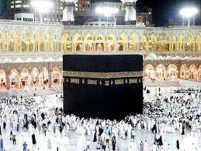
Special Mosque – KaAbah
There is a very special Mosque which is the house of Allah
  – this is called Kaaba and it is in Mecca
Many people visit the Kaaba
There is a time called Hajj where Millions of Muslims come together to
remember Allah
Hajj is also another Pillar of Islam

Slide 9
Prophet Mohammed
Do you know what is a prophet? Can you give me a name of a prophet you know?
Muslims believe in many prophets such as Adam, Moses, Abraham, Jesus and Noah.
They believe the last prophet is Mohammed.
Prophet Mohammed came to give the message of Allah and guide people

Slide 10
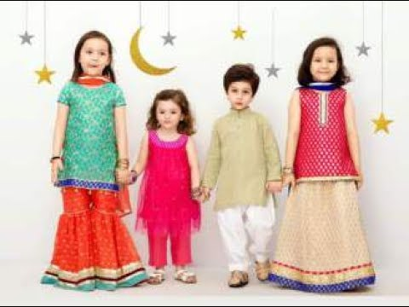
Eid
Can you name me some festivals or Celebrations?
What do you do at those Celebrations?
Eid is a special festival which is celebrated by Muslims.
During Eid – Muslims pray to Allah, visit friends and family, give gifts and hugs
They say
  EID MUBARAK!!!

Slide 11

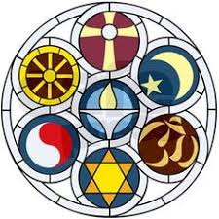





Thank you for listening
Questions
Sara Ashraf and Asad Rana
Cambourne Crescent www.cambournecrescent.org

Slide 12
Quiz
EID
FIVE
What Religion do Muslims Follow?
How many times do Muslims Pray in a day?
Where is the special place where Muslims pray together?
What is the name of the last prophet of Muslims?
What is the special festival called?
ISLAM
MOHAMMED
MOSQUES

