Slide 1
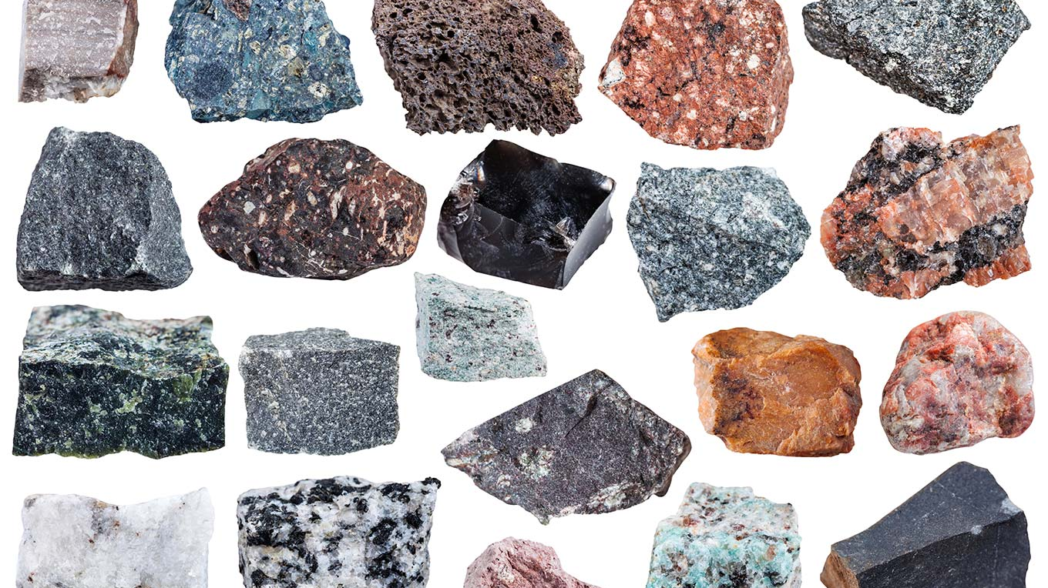
Igneous Rocks
The Romans used igneous rocks for paving roads.
We use igneous rocks for kitchen worktops.

Slide 2
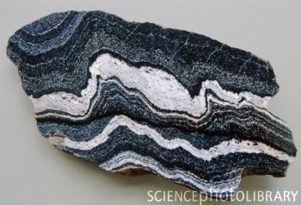
Metamorphic Rocks
Metamorphic rocks are used for artwork like statues.
It is used as a building material.

Slide 3
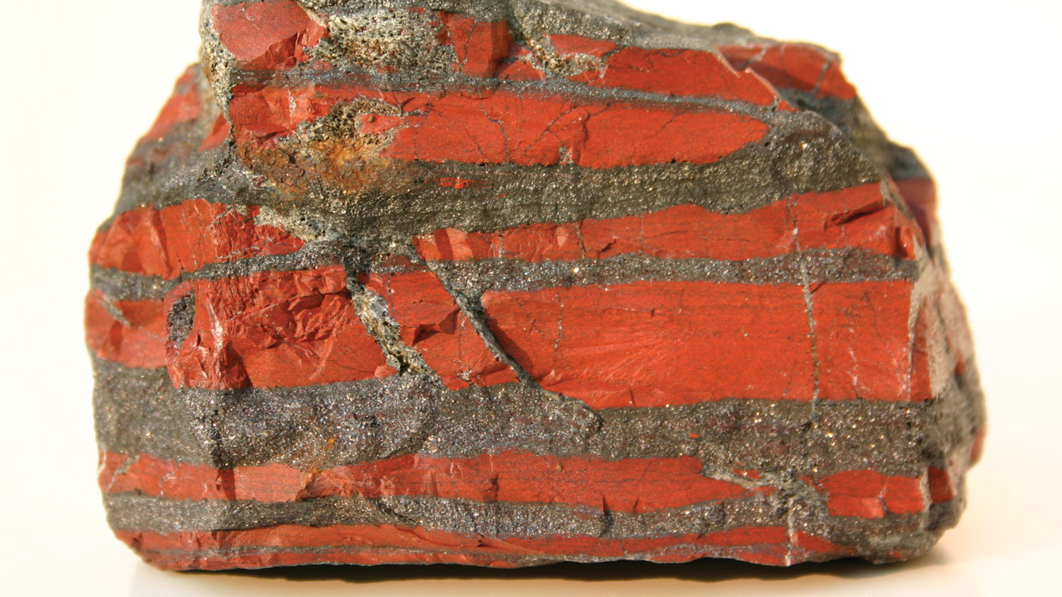
Sedimentary Rocks
Salt is used for flavouring.
Limestone is used for cement.

