Slide 1
Welcome to Barrington Church School

Slide 2
EYFS (Early Years Foundation Stage)
Prime areas – Communication and Language, Personal Social Emotional development and Physical development.
Specific areas – Literacy, Mathematics, Understanding the World, Expressive Arts and Design.

Slide 3
What will my child do all day?
Arrive at 8.45am – change reading books, choose lunch and make own choices about where they would like to explore.
9am – Register, introduce activities.
9.20-10.20am –Guided activities with teacher and teaching assistant and choice of challenge activities.
10.20-10.40am – Phonics
10.40-11am - Fruit and Playtime
11-12.20 - Guided activities with teacher and teaching assistant and choice of challenge activities.
12.20-1.30 - Lunch
1.30-3.00 - Guided activities with teacher and teaching assistant and choice of challenge activities.
3-3.25 – Story and assembly

Slide 4
September 2018 – Workshop for parents showing how we teacher phonics and how this links to reading and writing development.

Slide 5
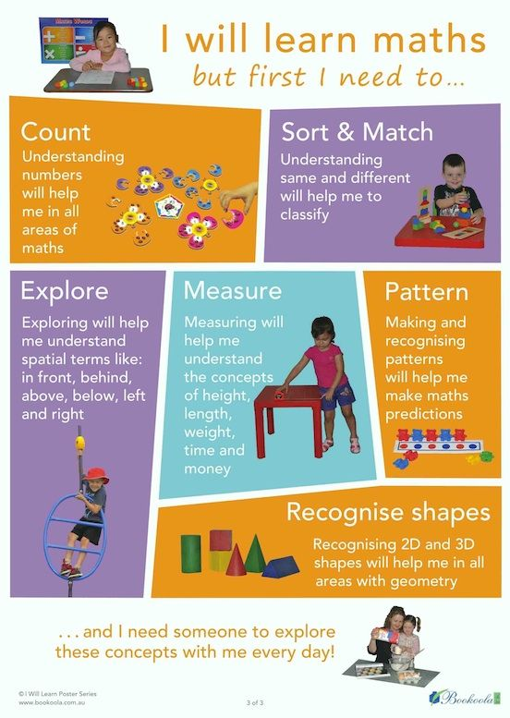

Slide 6
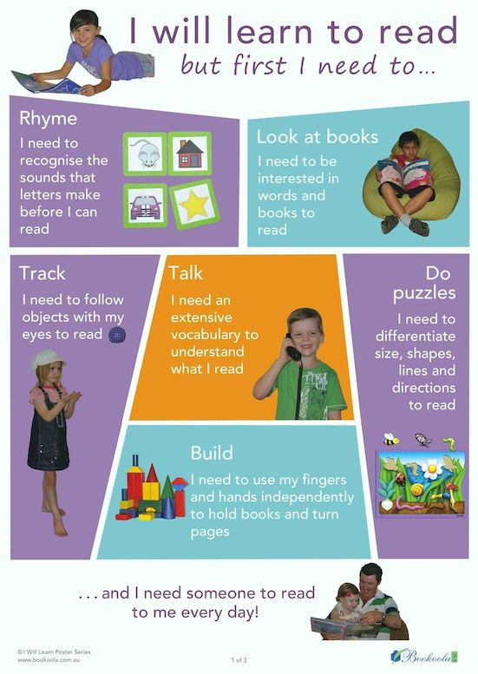

Slide 8
Have a lovely summer and we will see you in September.

