Slide 1
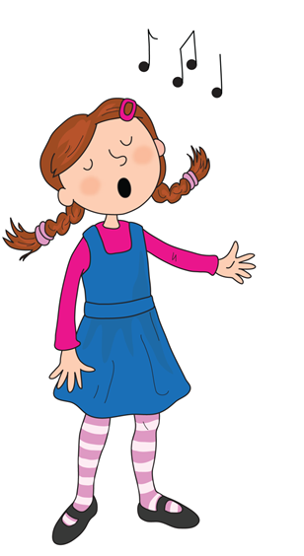
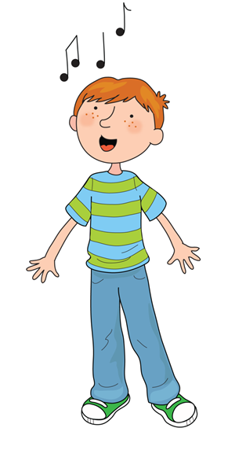
Song of Sounds

Slide 2

We can sing a song of sounds, skip to my lou my darling

Slide 3

Ants on an apple a a a

Slide 4

Butterflies are beautiful b b b

Slide 5

Caterpillars coughing c c c

Slide 6
Skip to my lou my darling

Slide 7

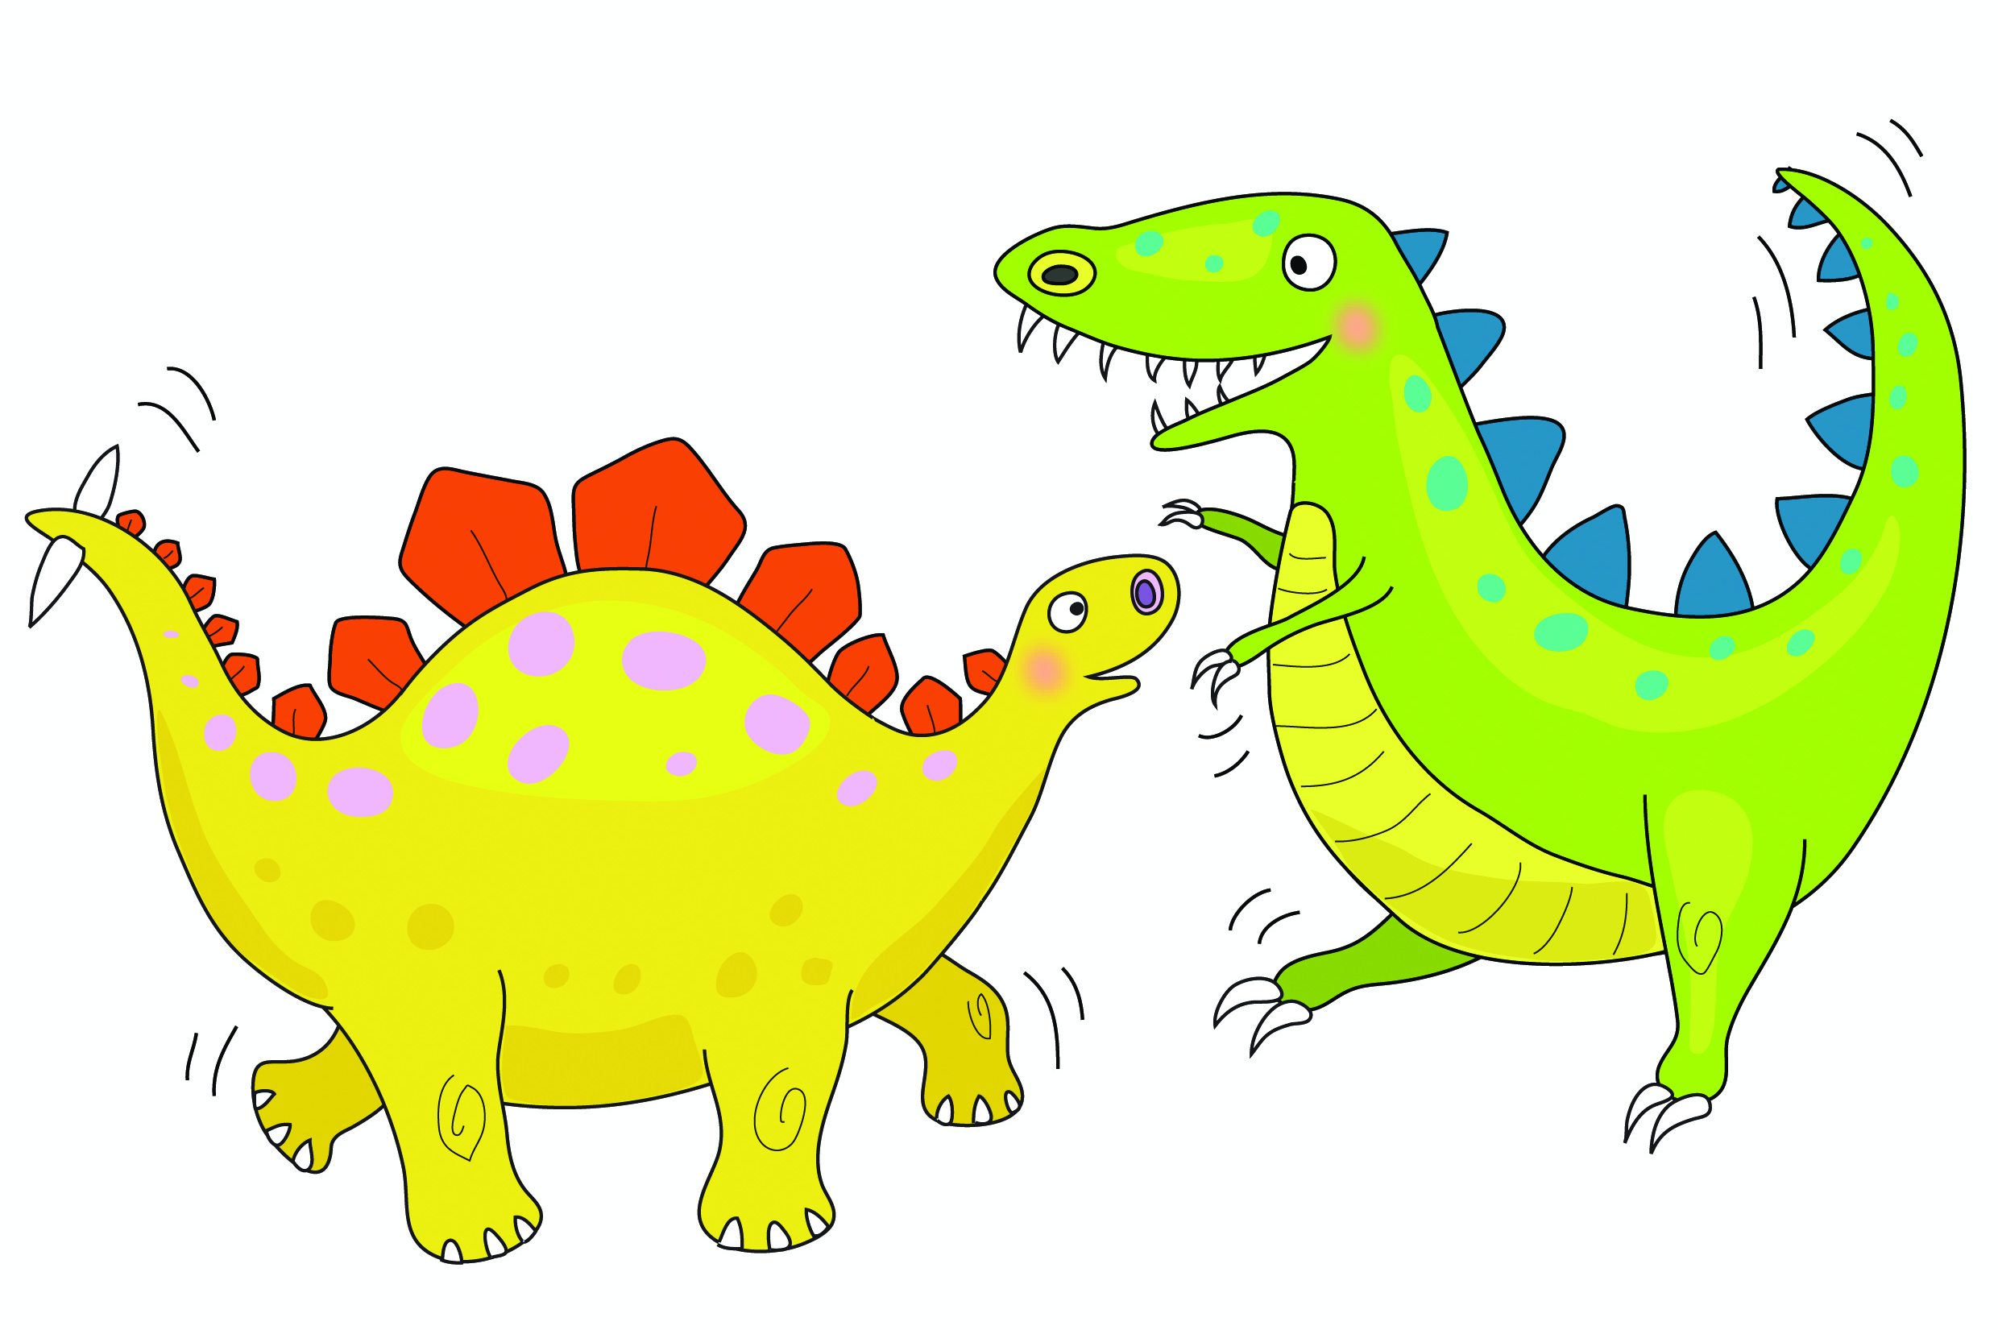
Dinosaurs are dancing d d d

Slide 8
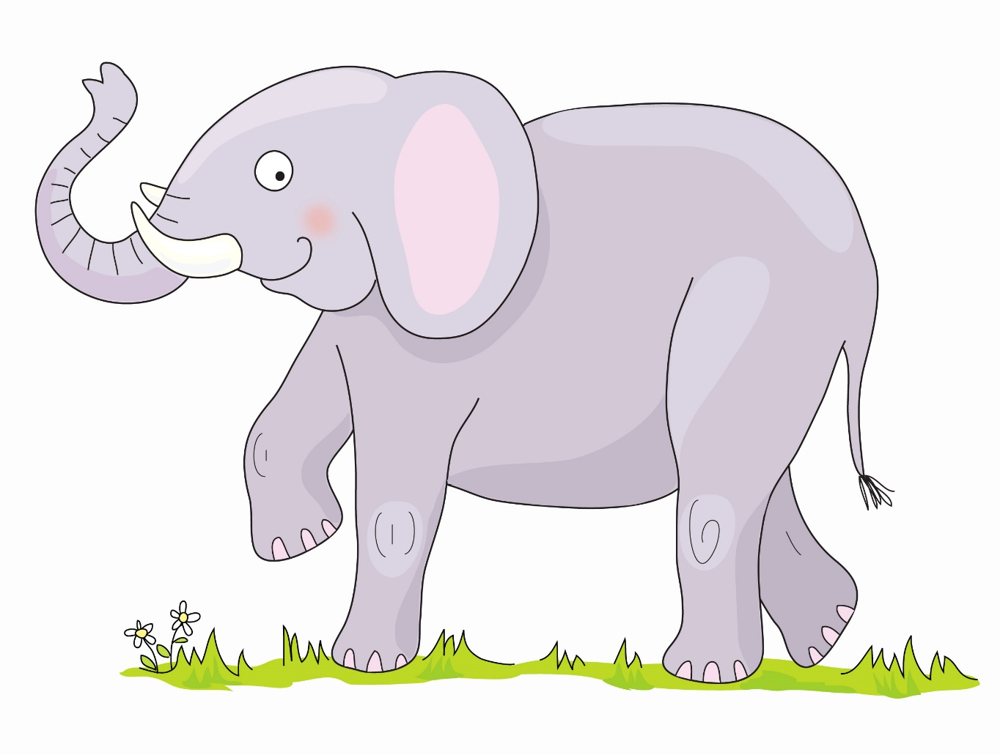

Elephant’s enormous e e e

Slide 9

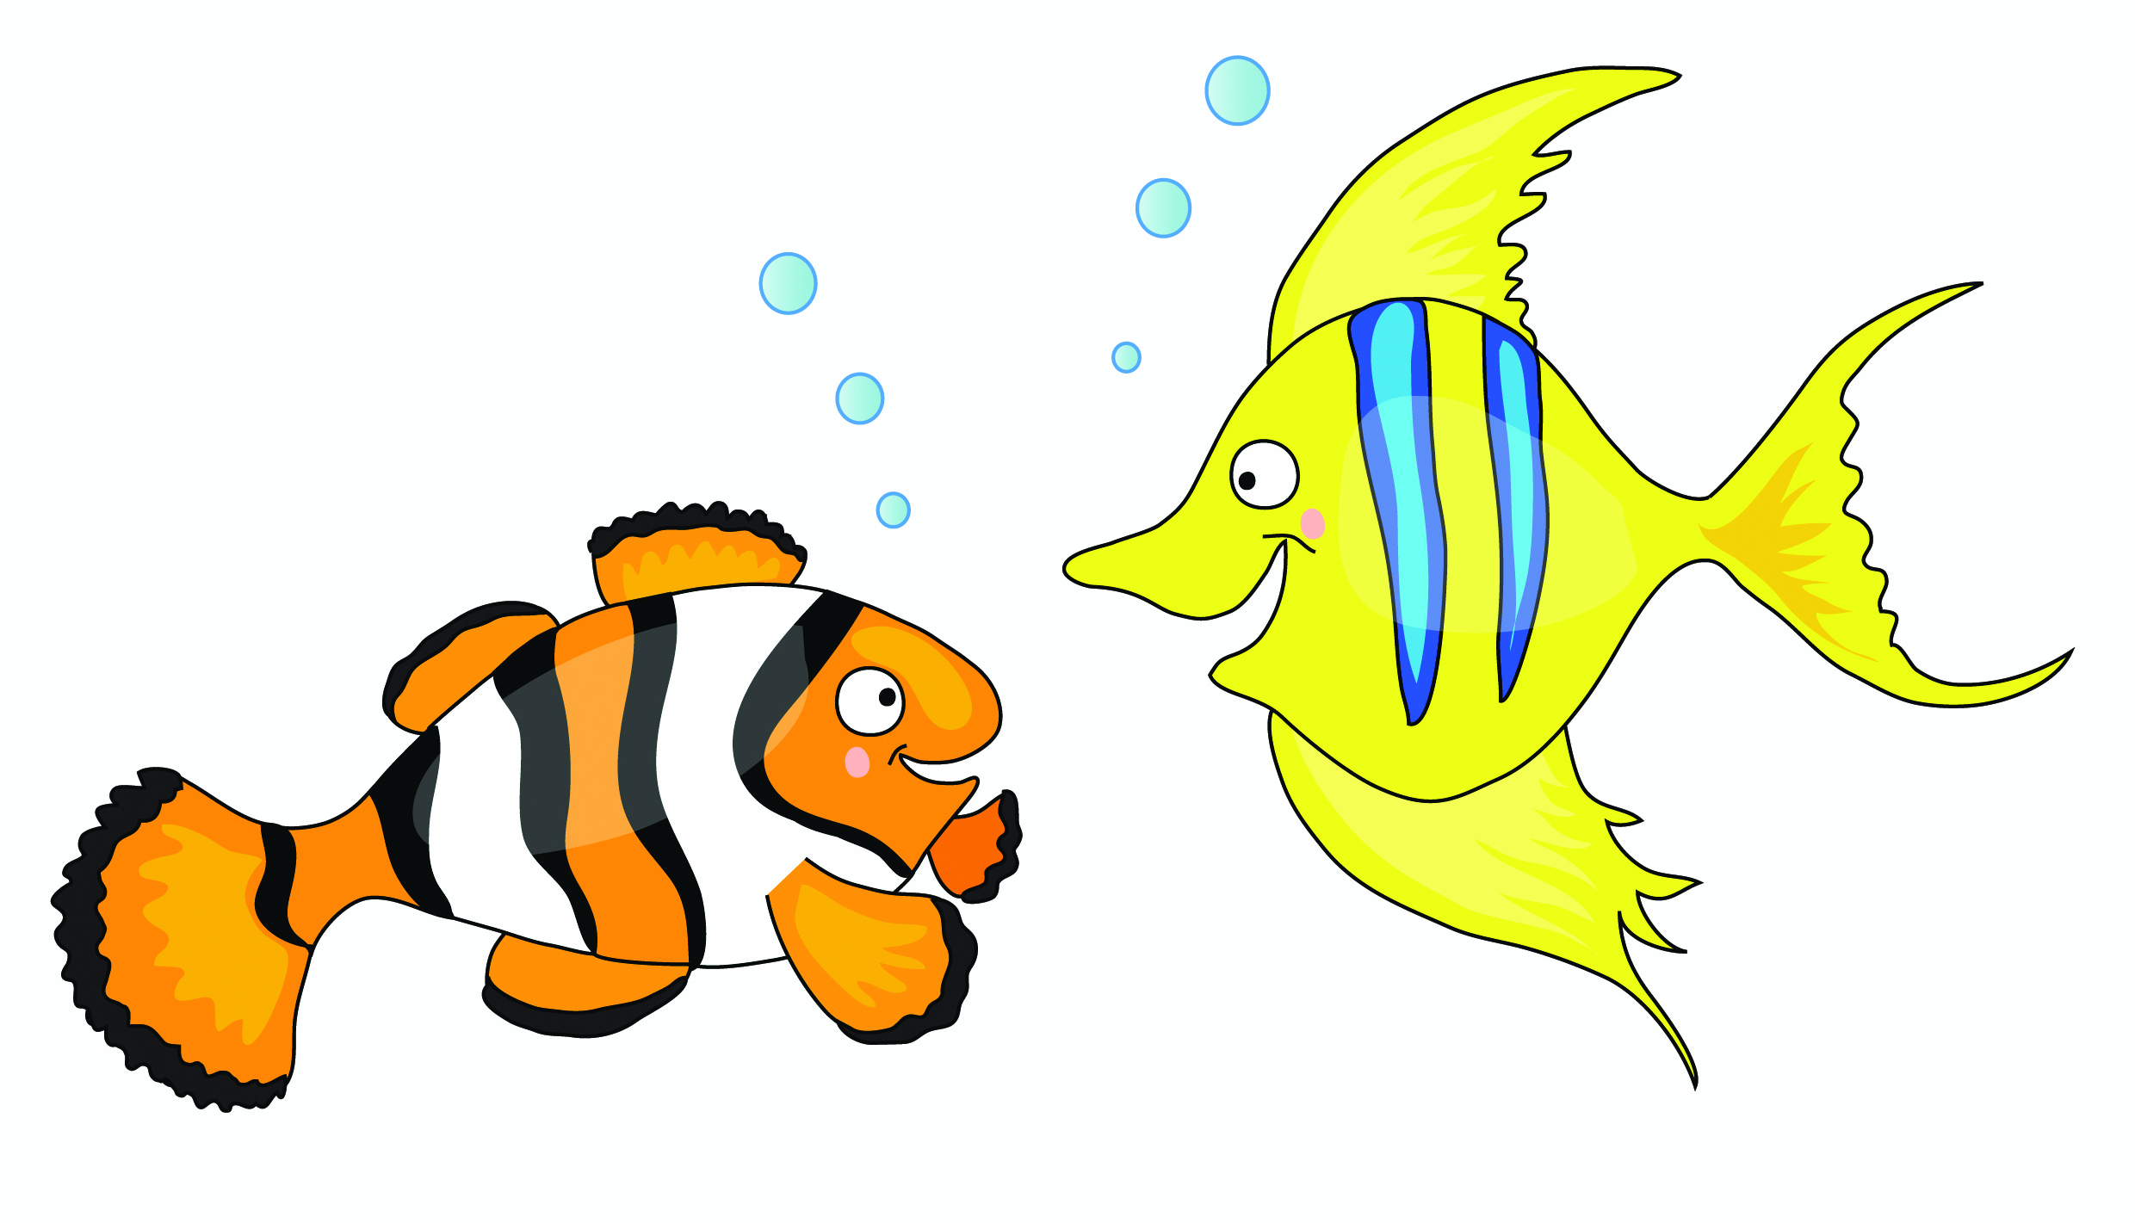
Fish are funny f f f

Slide 10
Skip to my lou my darling

Slide 11

Goats are gardening g g g

Slide 12

Hats on heads h h h

Slide 13

Insects are interesting i i i

Slide 14
Skip to my lou my darling

Slide 15

Jellybeans are jumping j j j

Slide 16

Kings flying kites k k k

Slide 17

Lions love lollipops l l l

Slide 18
Skip to my lou my darling

Slide 19

Mice are munching m m m

Slide 20

Nurse Nelly’s nice n n n

Slide 21

Octopus is orange o o o

Slide 22
Skip to my lou my darling

Slide 23

Popcorn popping p p p

Slide 24
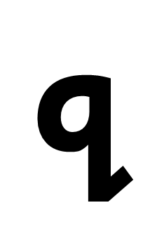

Queens run quickly qu qu qu

Slide 25

Rabbits are rascals r r r

Slide 26
Skip to my lou my darling

Slide 27

Sausages are sizzling s s s

Slide 28

Tiger on the TV t t t

Slide 29
Umbrellas up u u u

Slide 30
Skip to my lou my darling

Slide 31

Val has a violin v v v

Slide 32

Whales in the water w w w

Slide 33

Fox on a box x x x

Slide 34
Skip to my lou my darling

Slide 35

Yellow yoyo y y y

Slide 36

Zebras in the zoo z z z

Slide 37
Sing a song ng ng ng

Slide 38
Skip to my lou my darling

Slide 39
Sharks on the shore sh sh sh

Slide 40
Chickens eating cheese ch ch ch

Slide 41
Thorn in my thumb th th th

Slide 42
Skip to my lou my darling

Slide 43
Train in the rain ai ai ai

Slide 44
Busy busy bee ee ee ee

Slide 45
Soar up high igh igh igh

Slide 46
Skip to my lou my darling

Slide 47
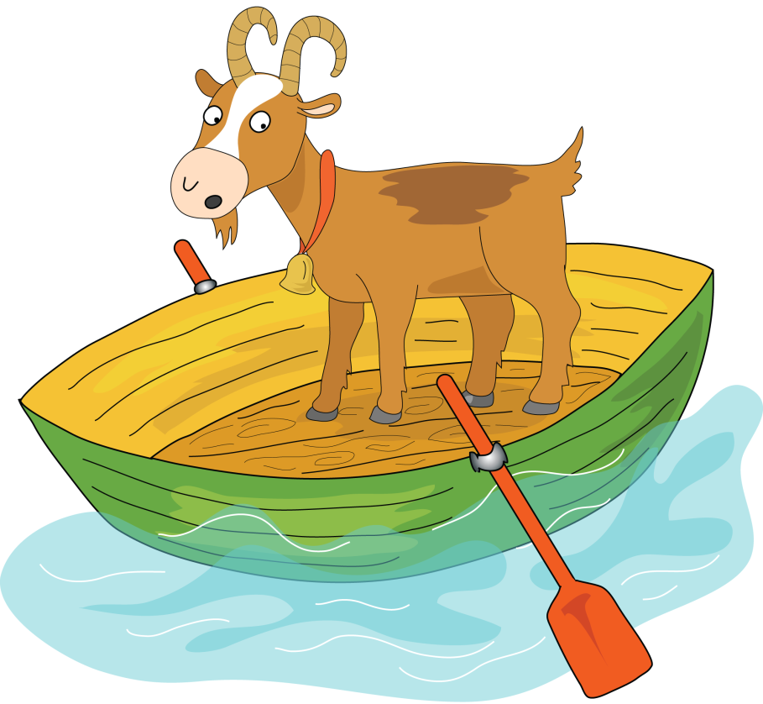

Goat on a boat oa oa oa

Slide 48
Zoom to the moon oo oo oo

Slide 49
Look in a book oo oo oo

Slide 50
Skip to my lou my darling

Slide 51
Go far in your car ar ar ar

Slide 52
It’s a horse of course or or or

Slide 53
Flower in a shower er er er

Slide 54
  Skip to my lou my darling

Slide 55

Don’t be noisy oi oi oi

Slide 56
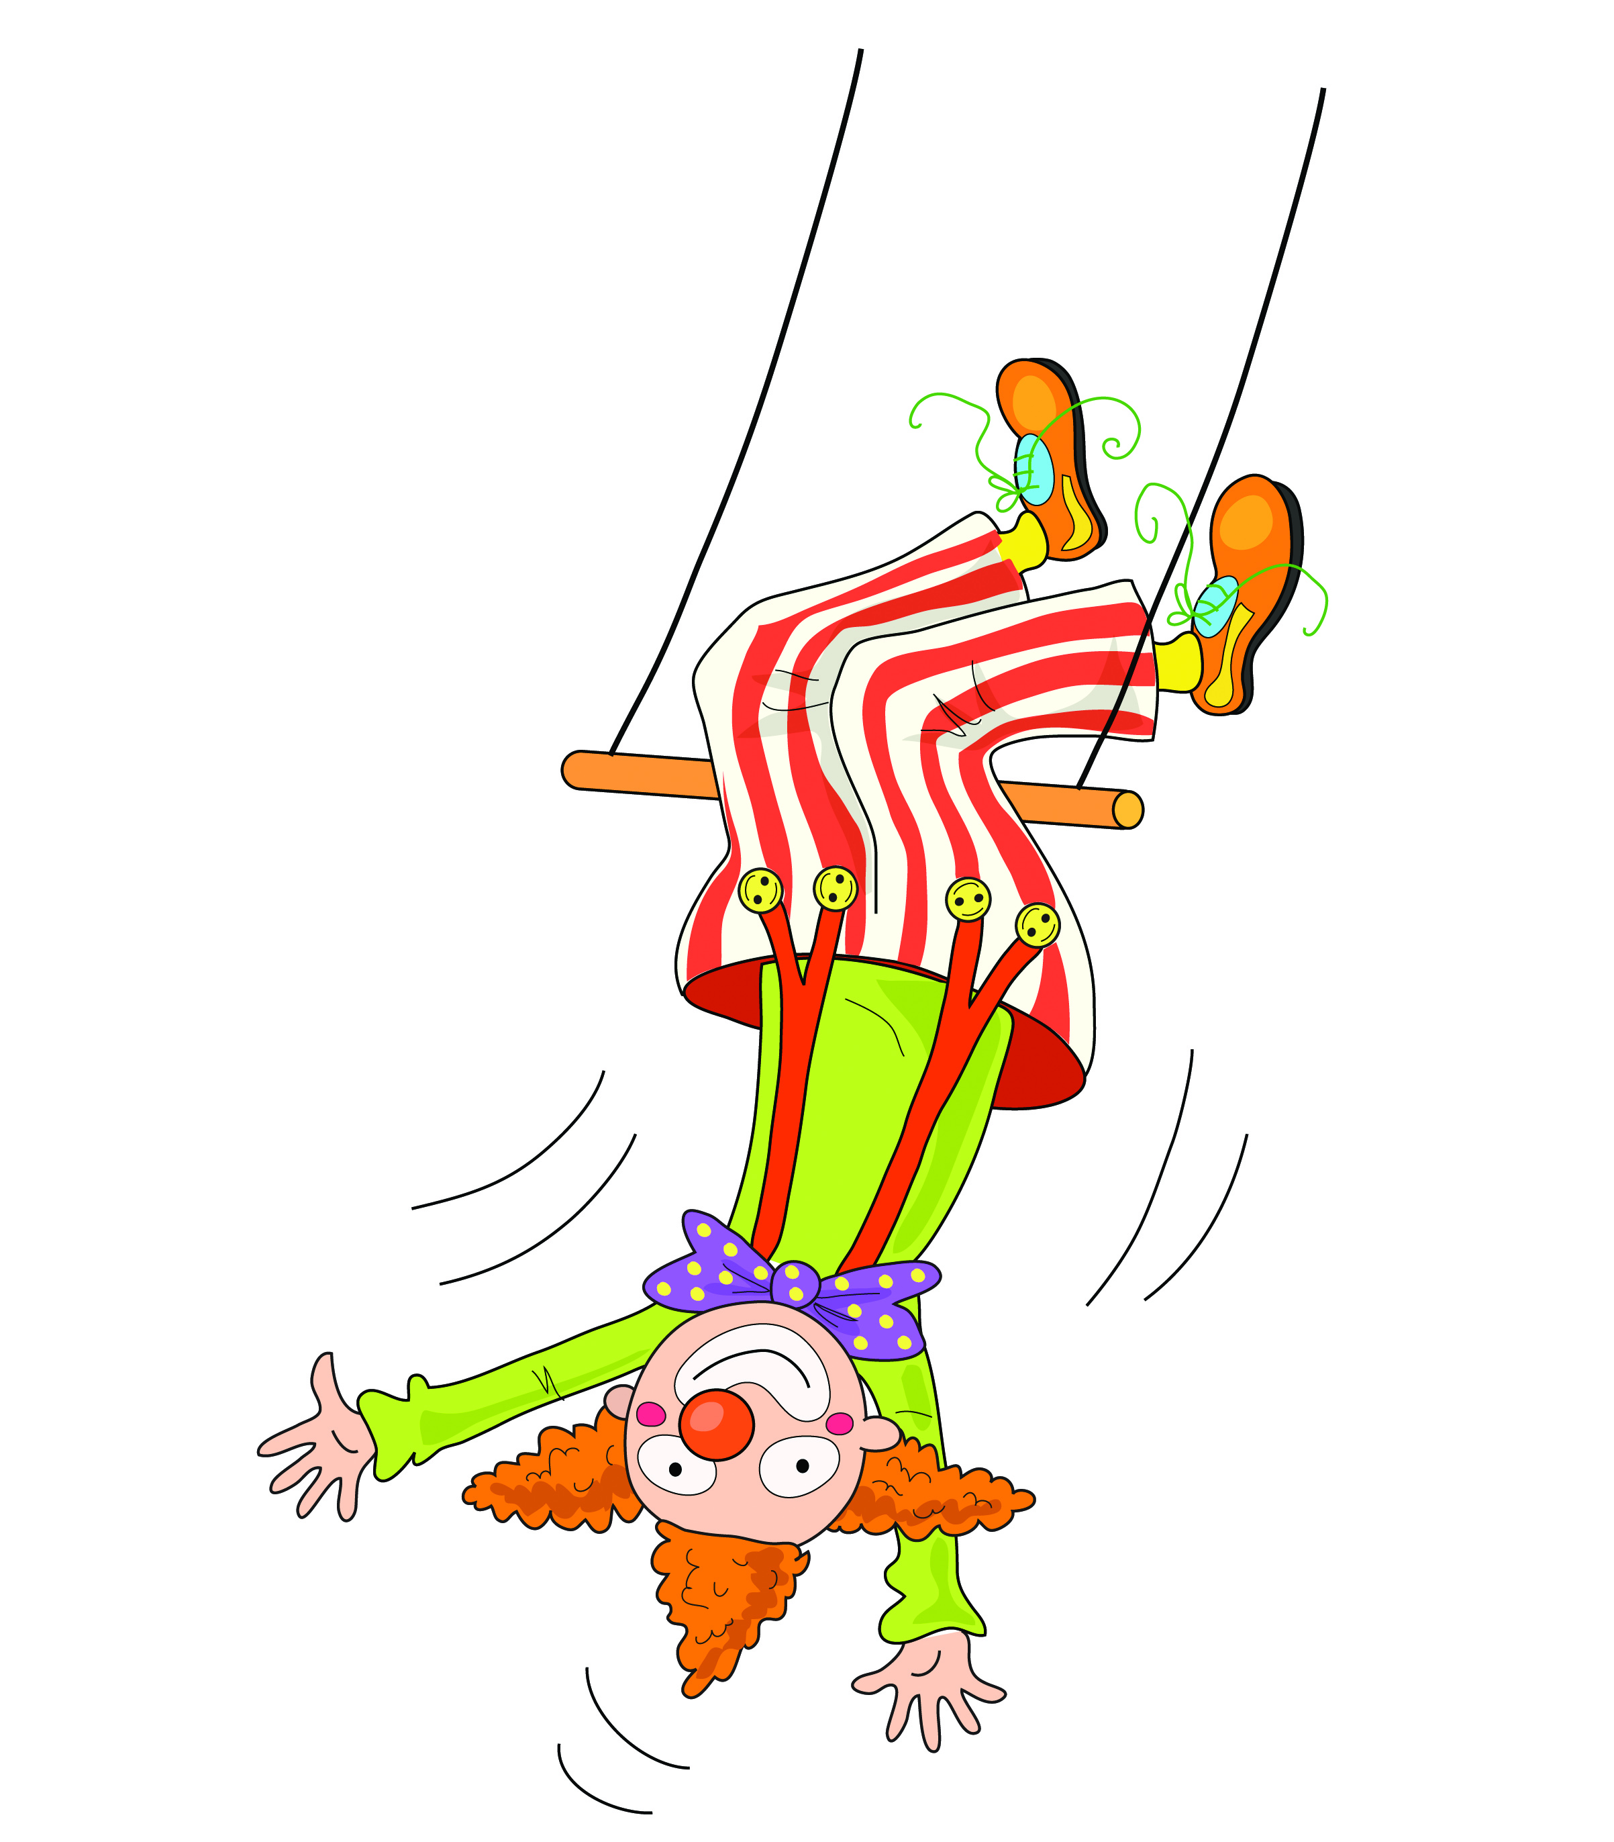

Clown upside down ow ow ow

Slide 57
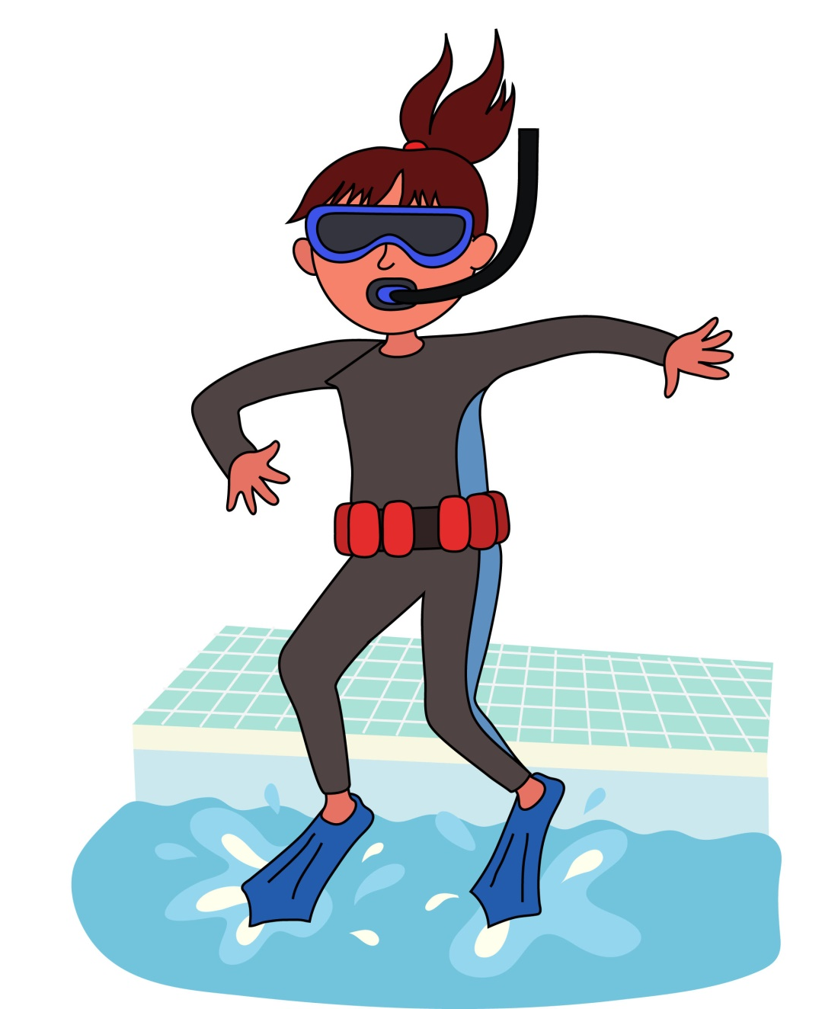
I think I will sink nk nk nk

Slide 58
  Skip to my lou my darling

Slide 59
Hairy fairy air air air

Slide 60
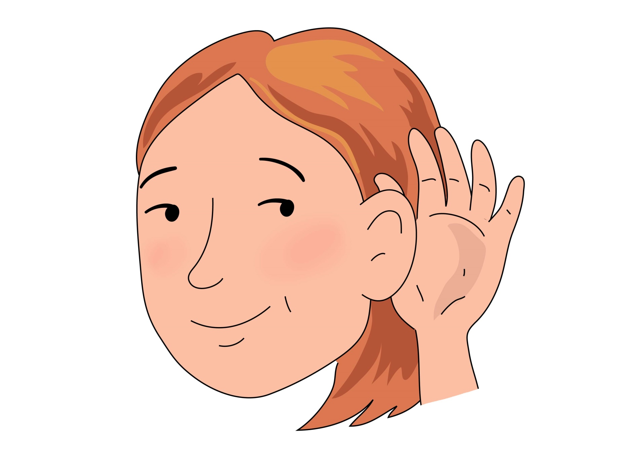

Hear with your ear
ear ear ear

Slide 61
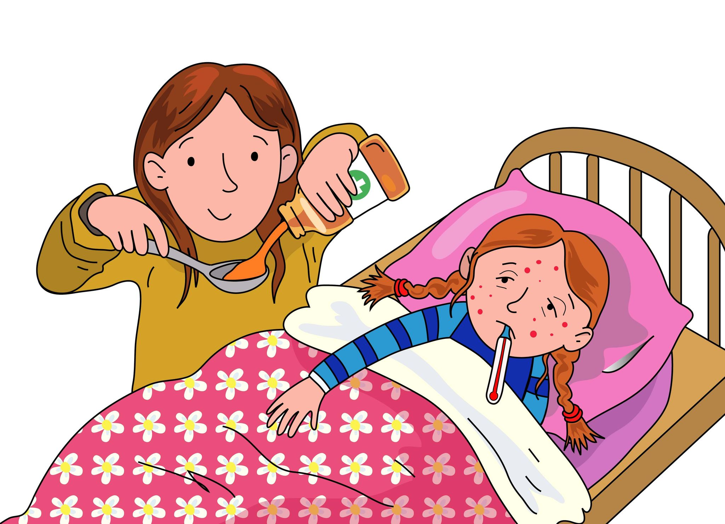

I’m sure there’s a cure ure ure ure

Slide 62
Skip to my lou my darling

Slide 63
Now we’ve sung our song to you, you can learn to blend sounds too.

Slide 64
Blending helps you read and write so sing this song all day and night.

