Slide 1

How we teach your child to read.

Slide 2
Reading
First we want children to enjoy listening to stories and looking a pictures in books. We aim to do this every day.
Encourage the children to use story language to retell stories either from pictures or in small world play using figures, dolls, cars etc. This helps to build up their vocabulary.

Slide 3
What skills do you need to read?
Being able to focus on and manipulate sounds/phonemes – know which sound has changed if you say car and cat. Can hear rhymes.
Phonics – the sounds letters make.
Fluency – Automatic word recognition to free up headspace for comprehension.
Vocabulary – Understanding meaning.
Comprehension – Taking meaning from text.

Slide 4
Phonics
At Barrington we use a scheme called ‘Song of Sounds’.
We have a phonics lesson every day for 15 minutes (gradually gets longer.)
4 new phonemes are introduced each week. We look at the name and sound of the letter. Think of words which might start with that sound and we learn the song and action which goes with the letter. We also look at the formation and that is our handwriting for the week.
Every day we recap all of the phonemes learned so far and we add the new one.
We have games which might be played on screen, played outside or in the classroom.

Slide 5
Sound buttons – individual sounds where there is only 1 letter eg a
Sound bar – a bar indicates a digraph where there is 1 sound but 2 or 3 letters eg ai

Slide 6
Tricky words
These are the words which children cannot work out using their phonetic knowledge.
We have 2 or 3 which we concentrate on every week. We practice reading and writing them everyday.

Slide 7
When the children have a bank of tricky words and phonemes which they know, they start to read.
They also use pictures and context clues to help work out what the text says.
Encourage them to point and follow the words with their finger.
Ask them about what they have read and what they think about events, the setting and the characters.

Slide 8
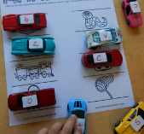
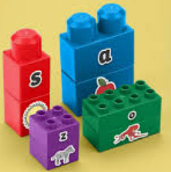
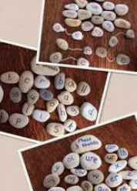
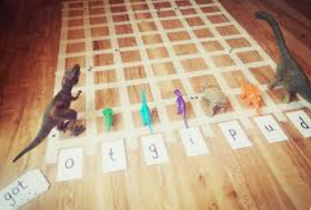
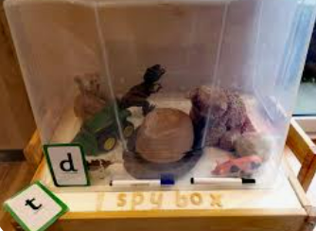
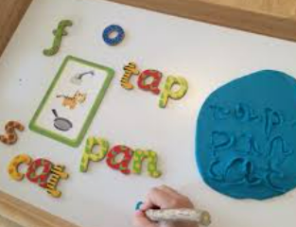

Slide 9
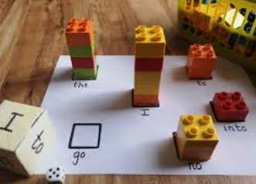
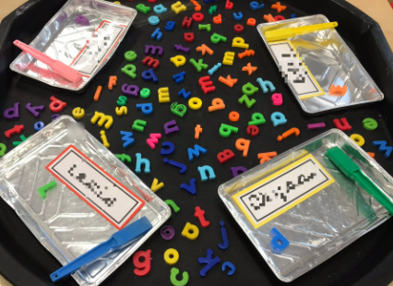
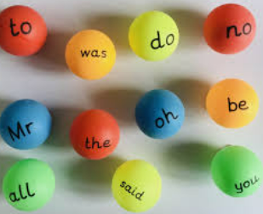
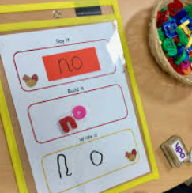

Slide 10
When to read!

Slide 11
When to change reading books?
We would like the children to read their book three times.
This will enable them to keep practising blending phonemes and remember tricky words. Each time they read they should become for fluent and not have to keep stopping to decode.

Slide 12
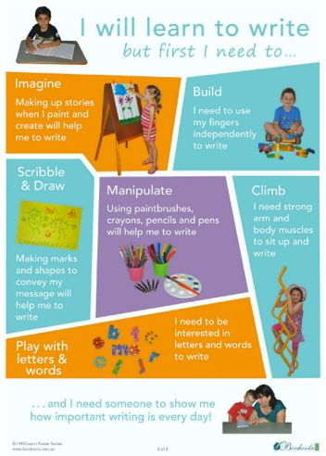
Writing
When we read we need blending skills.
When we write we need segmenting skills and remember what phonemes look like. We robot talk!
We also need to start writing tricky words.

Slide 13
I can write my name | I can write some recognisable letters when I write. | I am working on representing some sounds in order when I sound out | I can write initial and end sounds, eg writes dg for dog. | I can write cvc words eg dog. I am starting to write tricky words |  | I can write cvc wrds using some digraphs eg sock. I am starting to write more tricky words
I can write simple captions lists to match a picture, eg I can see… or I am… | I can write a simple sentence using my phonic knowledge and knowledge of tricky words. Eg The cat is big. | I am starting to use a full stop. I can reread what I have written. | I am starting to use some finger spaces between my words. I am forming my letters correctly. I am starting to use capital letters. |  | My writing can be read by others. Some words are spelled correctly and others are phonetically plausible I can spell many HFW words | My writing can be read by others. Some words are spelled correctly and others are phonetically plausible I can spell many HFW words

Slide 14


Slide 15
letter join

