Slide 1
Year 6 SATs 2023 Presentation for Parents

Slide 2
What are the SATs?
SATs are the Standardised Assessment Tests that are given to children at the end of Key Stage 2.
The SATs take place over four days, starting on Tuesday 9th May ending on Friday 12th May. Monday 8th May is a bank holiday this year.
The SATs papers consist of:
Grammar, punctuation and spelling (paper 1: GPS) – Tuesday 9th May
Grammar, punctuation and spelling (paper 2: Spelling) – Tuesday 9th May
Reading – Wednesday 10th May
Maths (paper 1: Arithmetic) – Thursday 11th May
Maths (paper 2: Reasoning) – Thursday 11th May
Maths (paper 3: Reasoning) – Friday 12th May
Writing is assessed using evidence collected throughout Year 6. There is no Year 6 SATs writing test.

Slide 3
When and how the SATs are completed
The tests take place during normal school hours, under exam conditions.
Children will be split into smaller groups to undertake the tests in rooms across the school.
Children are not allowed to talk to each other from the moment the assessments are handed out until they are collected at the end of the test.
There will be adults in the room that the children are familiar with, supporting them to stay on task.
After the tests are completed, the papers are sent away to be marked externally.
The results are then sent to the school in July.
Spelling, punctuation and grammar (paper 1: Grammar/ Punctuation) – 45 minutes
Spelling, punctuation and grammar (paper 2: Spelling) – 15 minutes
Reading – 60 minutes
Maths (paper 1: Arithmetic) – 30 minutes
Maths (paper 2: Reasoning) – 40 minutes
Maths (paper 3: Reasoning) – 40 minutes

Slide 4
Specific arrangements for SATs
Children with additional needs (who have similar support as part of day-to-day learning in school) may be allotted specific arrangements, including:
Additional (extra) time;
An adult to scribe (write) for them;
Using word processors independently;
An adult to read for them (including a translator);
The use of prompts or rest breaks;
Arrangements for children who are ill or injured at the time of the tests.

Slide 5
The results
Tests are marked externally. Once marked, the tests will be given the following scores:
A raw score (total number of marks achieved for each paper);
A scaled score (see below);
A judgement on if the National Standard has been met.
After marking each test, the external marker will convert the raw score to a scaled score. Even though the tests are made to the same standard each year, the questions must be different. This means the difficulty of the tests may vary. Scaled scores ensures an accurate comparison of performance over time.
Scaled scores range from 80 to 120.
A scaled score of 100 or more shows the pupil is meeting the National Standard.

Slide 6
Grammar, Punctuation and Spelling: Tuesday 9th May
Grammar, punctuation and spelling consists of two papers.
Paper 1 focuses on all three elements (grammar, punctuation and spelling or GPS). The paper lasts for 45 minutes.
Paper 2 consists of a spelling test only. It should take approximately 15 minutes, although this is not a set amount of time (pupils will be given as much time as they need to complete the test).

Slide 7
Grammar, Punctuation and Spelling: Paper 1 (GPS)
The children have been working hard with on developing and securing their knowledge of the technical vocabulary needed in this test.
This test focuses on:
Grammatical terms/ word classes;
Functions of sentences;
Combining words, phrases and clauses;
Verb forms, tenses and consistency;
Punctuation;
Vocabulary;
Standard English and formality.

Slide 8
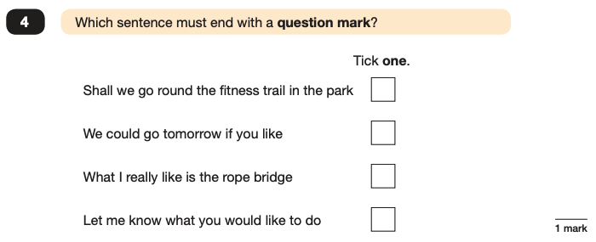
Grammar, Punctuation and Spelling: Paper 1 (GPS)
Example questions:
✓
e.g. Although, While
e.g. Switch off the lights! Please turn off the lights

Slide 9
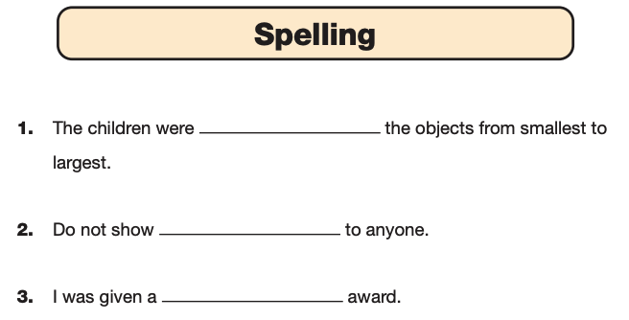
Grammar, Punctuation and Spelling: Paper 2 (spelling)
Paper 2 is a shorter paper that focuses solely on spellings.
Example questions:

Slide 10
Reading: Wednesday 10th May
There is one reading test that lasts for 60 minutes.
The test is designed to measure if the children’s comprehension of age-appropriate reading material meets the national standard. There are three different set texts for children to read. These could be any combination of non-fiction, fiction and/ or poetry.
The test covers the following areas:
Give/ explain the meaning of words in context;
Retrieve and record information/ identify key details from fiction and non-fiction;
Summarise main ideas from more than one paragraph;
Make inferences from the text/ explain and justify inferences with evidence from the text;
Predict what might happen from details stated and implied;
Identify/ explain how information/ narrative content is related and contributes to meaning as a whole;
Identify/ explain how meaning is enhanced through choice of words and phrases;
Make comparisons within the text.

Slide 11
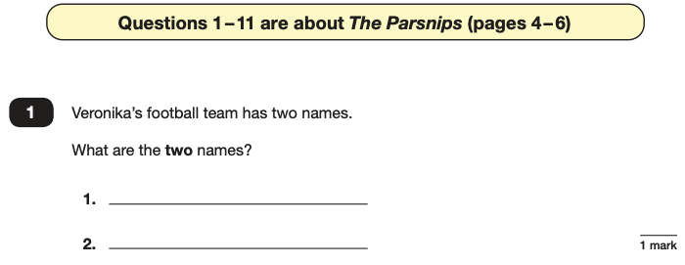
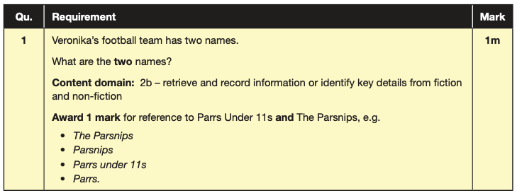
Reading
The reading SATs paper requires a range of answer styles.
Example questions:

Slide 12
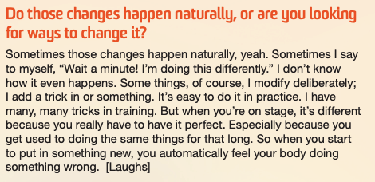
Reading
Example questions:
Based on text 2: My Circus Life

Slide 13
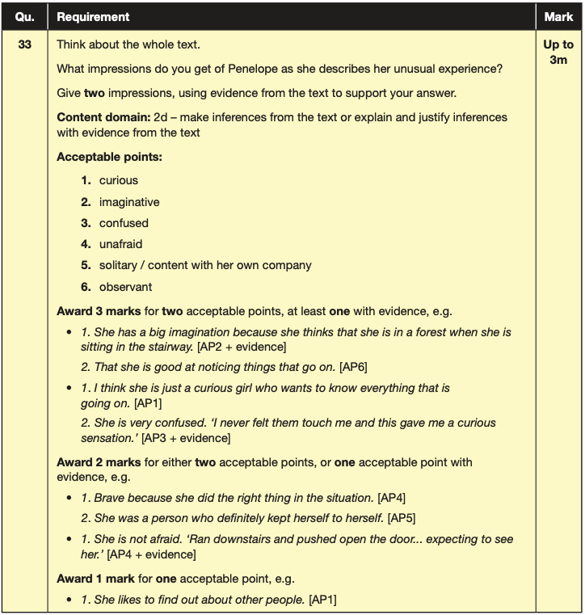
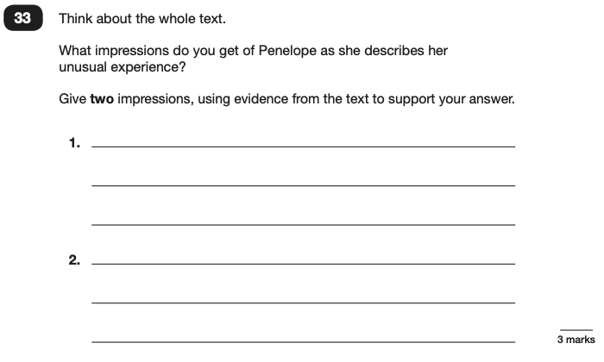
Reading
Example questions:
Based on the whole text

Slide 14
Reading
Since the current testing formation for the SATs began in 2016, there has been a tendency for three types of questions to be the most popular.
In the 2022 Reading SATs paper,
10% of marks could be gained from answering questions involving giving and explaining the meaning of words in context;
38% of marks could be gained from answering questions involving retrieving and recording information or identifying key details from a text;
44% of marks could be gained from answering questions involving making inferences from a text and justifying inferences with text evidence.
When reading with your child at home try focusing on these types of questions.

Slide 15
Maths: Thursday 11th May and Friday 12th May
The maths assessments consist of three tests.
Paper 1: Arithmetic (30 minutes) – Thursday 11th May
Paper 2: Reasoning (40 minutes) – Thursday 11th May
Paper 3: Reasoning (40 minutes) – Friday 12th May

Slide 16
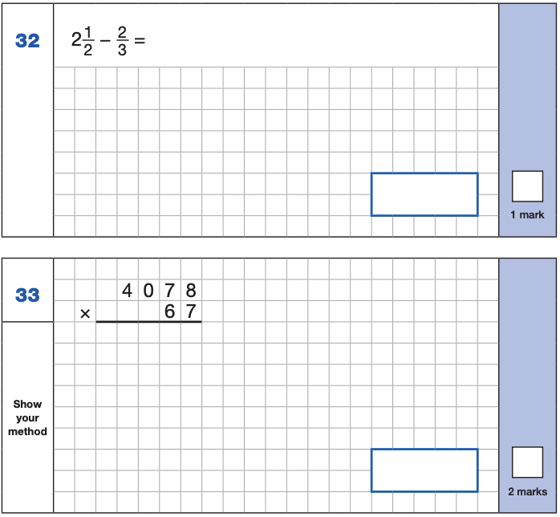
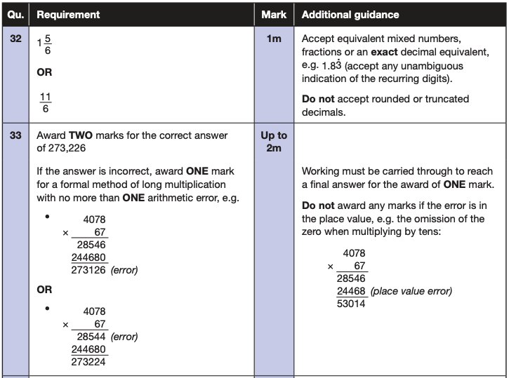
Maths Paper 1 (Arithmetic)
The maths arithmetic paper has a total of 40 marks and lasts for 30 minutes.
The test covers the four operations (addition, subtraction, multiplication, division, including order of operations requiring BIDMAS), percentages of amounts and calculating with decimals and fractions.
Example questions:

Slide 17
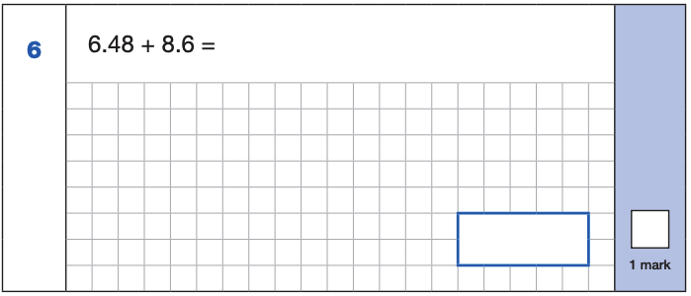
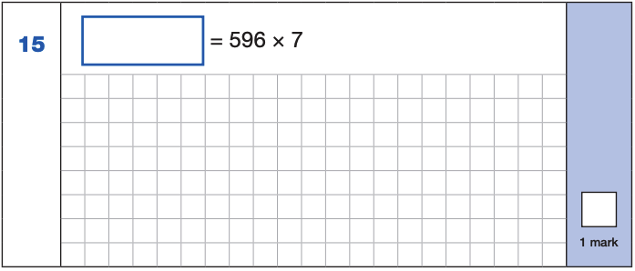
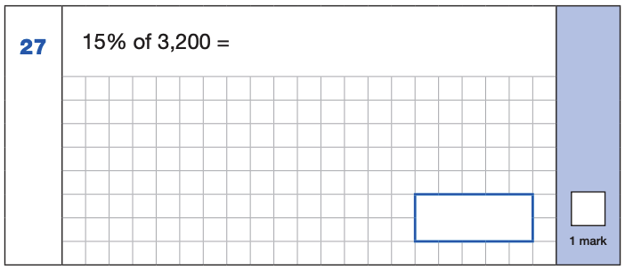
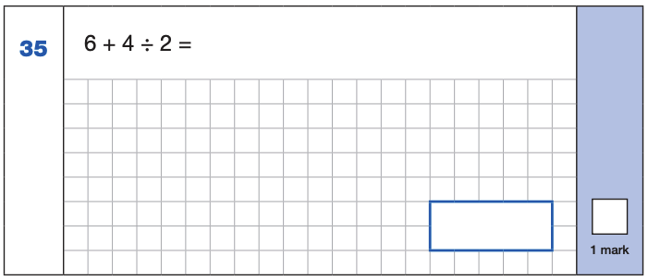
Maths Paper 1 (Arithmetic)
Example 1 mark questions:
4,172
6.48
+ 8.6 .
15.08
¹
596
x 7
4172
⁶ ⁴
15.08
10% of 3,200 = 320
5% of 3,200 = 160
15% of 3,200 = 480
4 ÷ 2 = 2
6 + 2 = 8
480
8

Slide 18
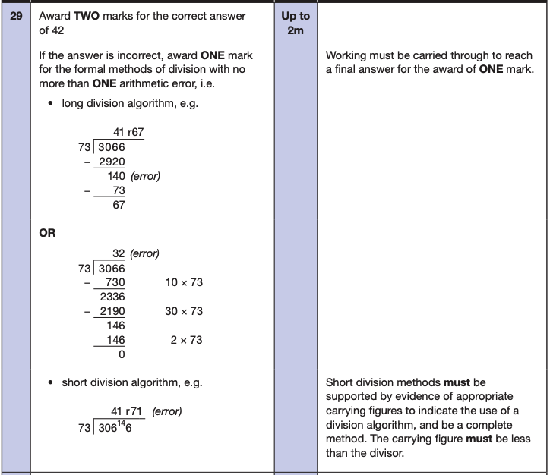
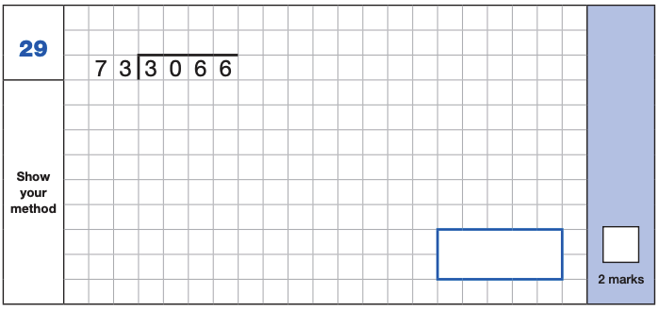
Maths Paper 1 (Arithmetic)
Example 2 mark question:

Slide 19
Maths Papers 2 and 3 (Reasoning)
Paper 2 will take place on Thursday 11th May and paper 3 will take place on Friday 12th May. These tests have a total of 35 marks each and lasts for 40 minutes each.
These papers require children to demonstrate their mathematical knowledge and skills, as well as their ability to solve problems and their mathematical reasoning. They cover a wide range of mathematical topics from key stage 2 including,
Number and place value (including Roman numerals);
The four operations;
Geometry (properties of shape, position and direction);
Statistics;
Measurement (length, perimeter, mass, volume, time, money);
Algebra;
Ratio and proportion;
Fractions, decimals and percentages.

Slide 20
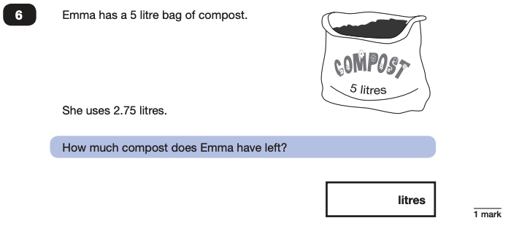
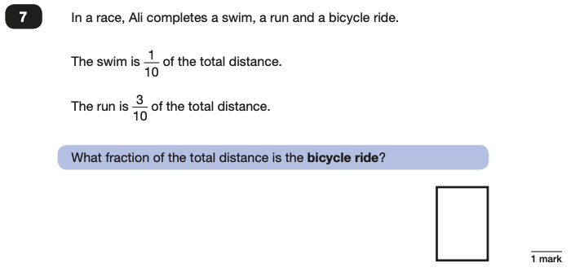
Maths Papers 2 (Reasoning)
Example questions:
2.25
$$\frac{\text{6}}{\text{10}}$$

Slide 21
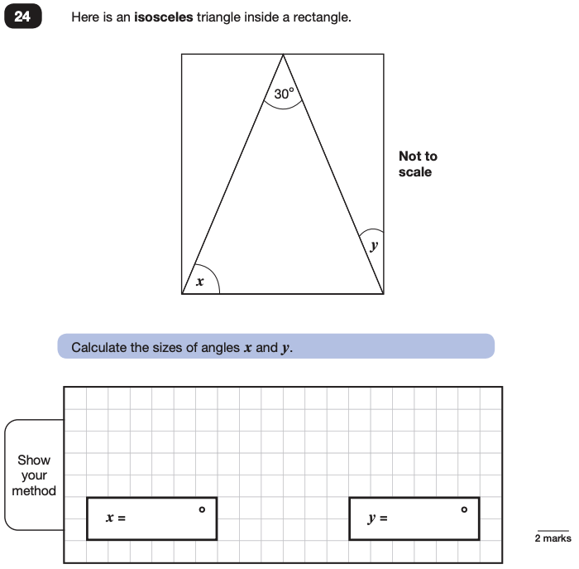
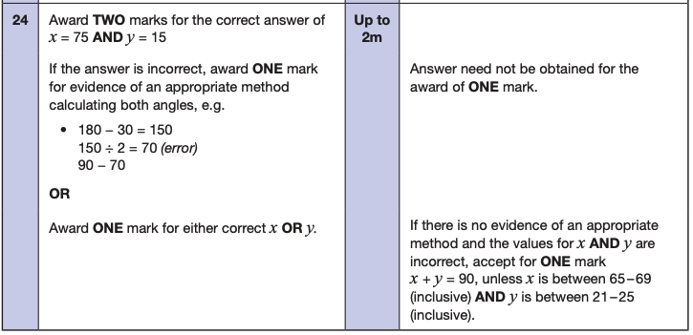
Maths Papers 2 (Reasoning)
Example question:

Slide 22
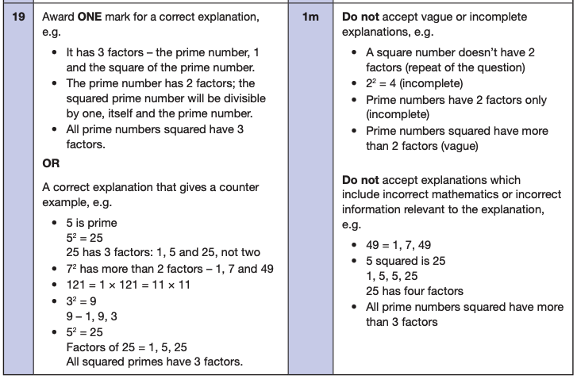
Maths Papers 3 (Reasoning)
Example questions:

Slide 23
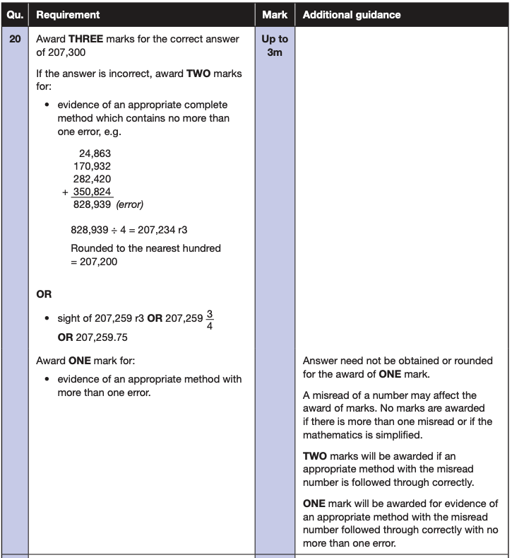
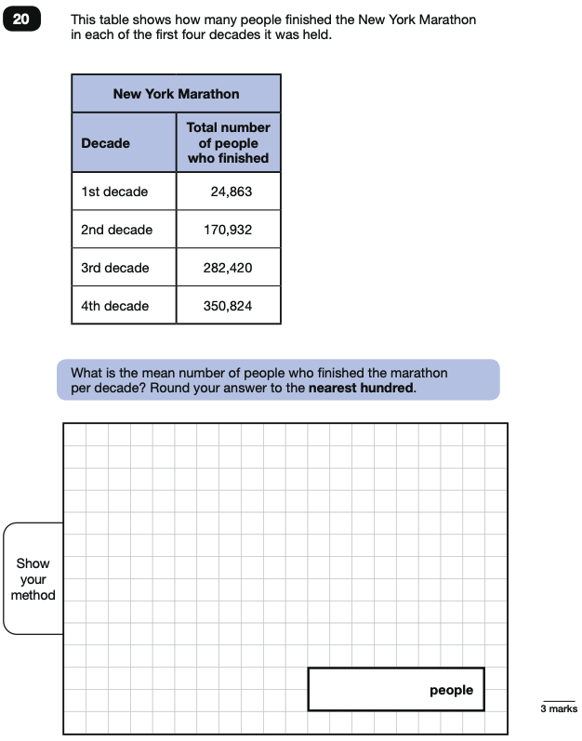
Maths Papers 3 (Reasoning)
Example question:

Slide 24
Supporting your child in preparing for the SATs
Firstly, a positive attitude goes a long way. Give them as much encouragement and support as you can (but we don’t need to tell you that)!
Tips:
Talk to school staff if you have any concerns.
Encourage your child to talk to a member of staff or a trusted adult (including yourself) about their anxieties. Don’t forget that a small amount of anxiety is normal and not harmful.
Give your child a quiet, distraction free space to complete homework or study.
Give your child time to go outside and reduce screen time.
Ensure your child is eating and drinking well and getting a good amount of sleep.
Plan something nice and fun for the weekends before and after SATs. This will help them to relax before the SATs and give them something to look forward to after.

Slide 25
Things to remember about SATs
SATs focus on what children know about Maths and English.
They will not reflect how talented they are at science, geography, art, PE…, and they certainly won’t highlight all of their amazing personal characteristics.
SATs don’t tell the whole story.
Their results will say if they did or did not meet a certain standard but not necessarily by what margin. These thresholds change each year according to the overall national performance, so what was classed as ‘meeting the expected standard’ this year might not be the same as last year.
SATs are only four days out of a whole Primary School career.
In reality, there’s one or two papers each day that last 30 to 60 minutes.

