Slide 1
Welcome to
Barrington C of E Primary School.

Slide 2
Preparing your child for full time school
Staggered start
Home visits, half will visit for a few hours either in the morning or afternoon. All the class will start but go home before lunch. The following week all will stay until after lunch. Each day we will keep 6 for an extra hour.
We have found over the years that this system is the best to introduce children into full time schooling.
Expect your child to be tired – even if they are used to nursery /preschool.
If your child is not ready for full time or is just very tired we can be flexible as to how much of a week they do for the first term.

Slide 3
Home visits!!!
It is established practice in many EYFS settings. Helps the formation of the relationship between the child, home and school.
Parents often feel more comfortable talking about their child in their own home.
Children remember that their teacher and teaching assistant have been to their house and are often more confident talking and showing us their toys.

Slide 4
If you have any worries about your child I am available in the classroom before the start of the day or at the end of the school day.
If you work and need to speak to us please feel free to leave a phone message or email school and then I can contact you.

Slide 5
We welcome your help in the classroom once your child is settled in school - if you have the time, this could be helping with reading/ creative work etc. or when we have trips we will need extra adults. We would ask you to fill in a DBS check form, this will cover you until your child leaves Barrington School.

Slide 6
Red class
We will have 30 children in Red class.
We devise lessons to cater for all levels of ability.

Slide 7
Toileting - One thing that can worry children when they start school is going to the toilet, to help them please try and get your child to be independent. We will sort the occasional mishap.
Dressing and undressing – Now is the time to start getting your child independent with their own clothes. This includes putting their coat on and off.

Slide 8
Uniform basic – blue trousers, yellow school logo polo shirts and blue school logo sweat shirt, blue skirts, pinafores or summer dresses in yellow or blue. For P.E. blue shorts and a school logo light blue t-shirt plimsolls and blue jogger bottoms for outside P.E. Please make sure your child is in shoes that they can fasten themselves! And please make sure all their clothes are named or it is very difficult to tell one jumper from another!

Slide 9
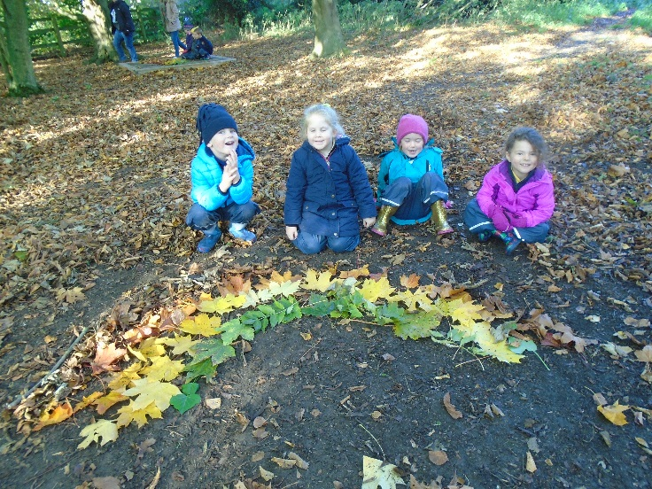
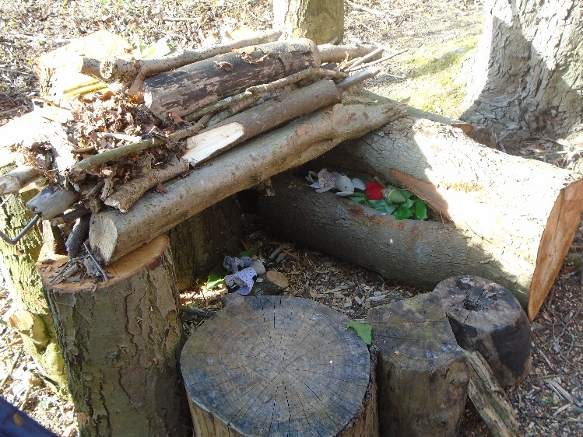
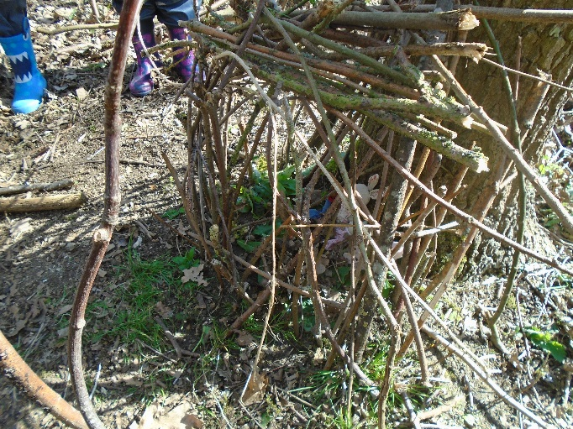
Forest school each week – need waterproofs and welly boots which are kept in school. We provide the overalls. We can only run forest school if we have parent helpers. A letter will go out in the Autumn term about dates and times.
Forest School

Slide 10
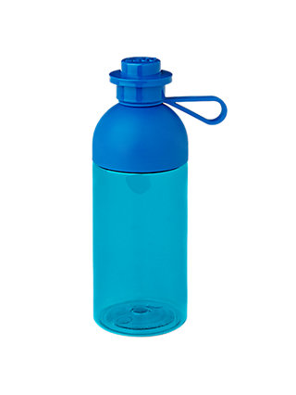
We ask that all children have a water bottle research has shown that children are able to learn more effectively if their brains are well hydrated. We ask that it is only water.
Fruit time – Every morning we have a short break for fruit this is provided by the government for all children in Reception and KS1 But if you wish you can send your child in with a healthy snack that you know they will eat.. Without a snack it is a long time for some children to wait until 12.00 for lunch!

Slide 11
In the morning children come into the classroom from 8.45am.
The register is taken at 8.55 if you arrive after this time and the register has been taken you will need to register your child in the office. Any child not in the classroom by the time the register is taken will have a late mark.

Slide 12
At home time could you please wait so we can see you from the doors into the playground- we will not let your child go until we see the person who collects them.
If another adult is collecting them please send a note so we know.

Slide 13
We will do a register for the bus, if you live in Shepreth.
If your child is not going on the bus please let us know.

Slide 17
WhatsApp
For the last few years parents have set up a group which all of Red class parents are part of.
We just need a volunteer to allow me to send their mobile number to the rest of the class so that a group can be set up before the summer holidays.

Slide 18
Name cards and
peg labels.

Slide 19
FOBS

Slide 20
https://eric.org.uk/children-with-additional-needs/help-with-toileting/

Slide 21
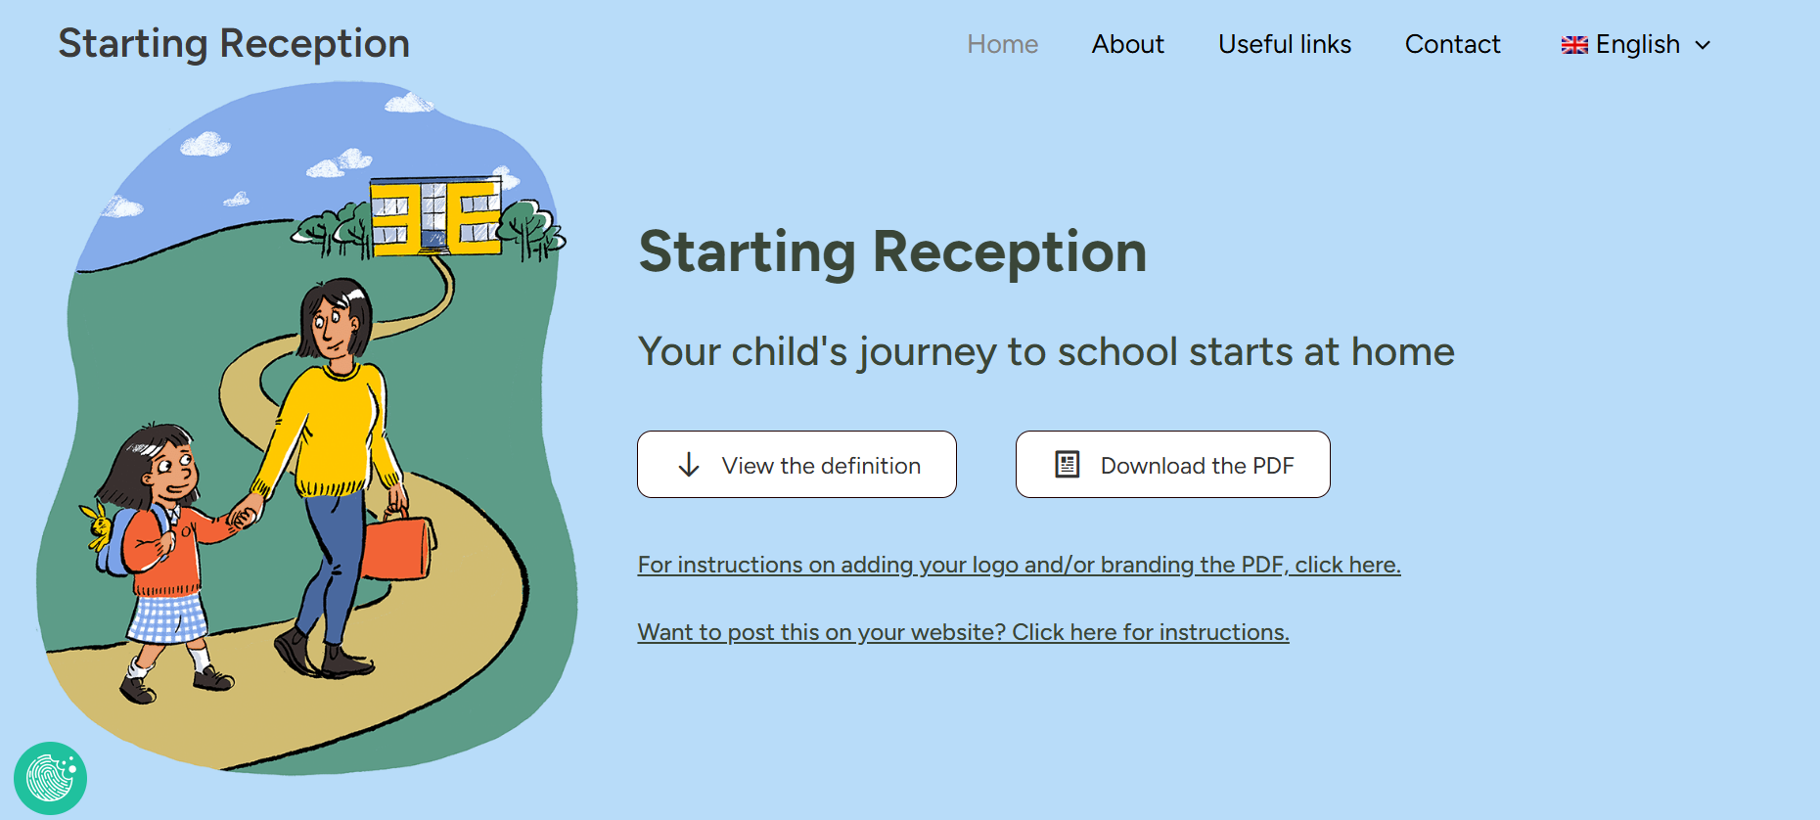
https://startingreception.co.uk/

