Slide 1
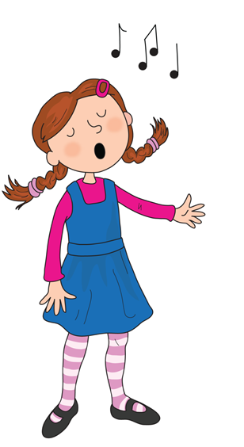
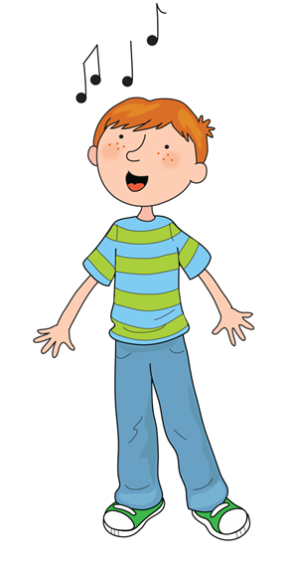
Song of Sounds

Slide 2
We can sing a song of sounds,
skip to my lou my darling

Slide 3
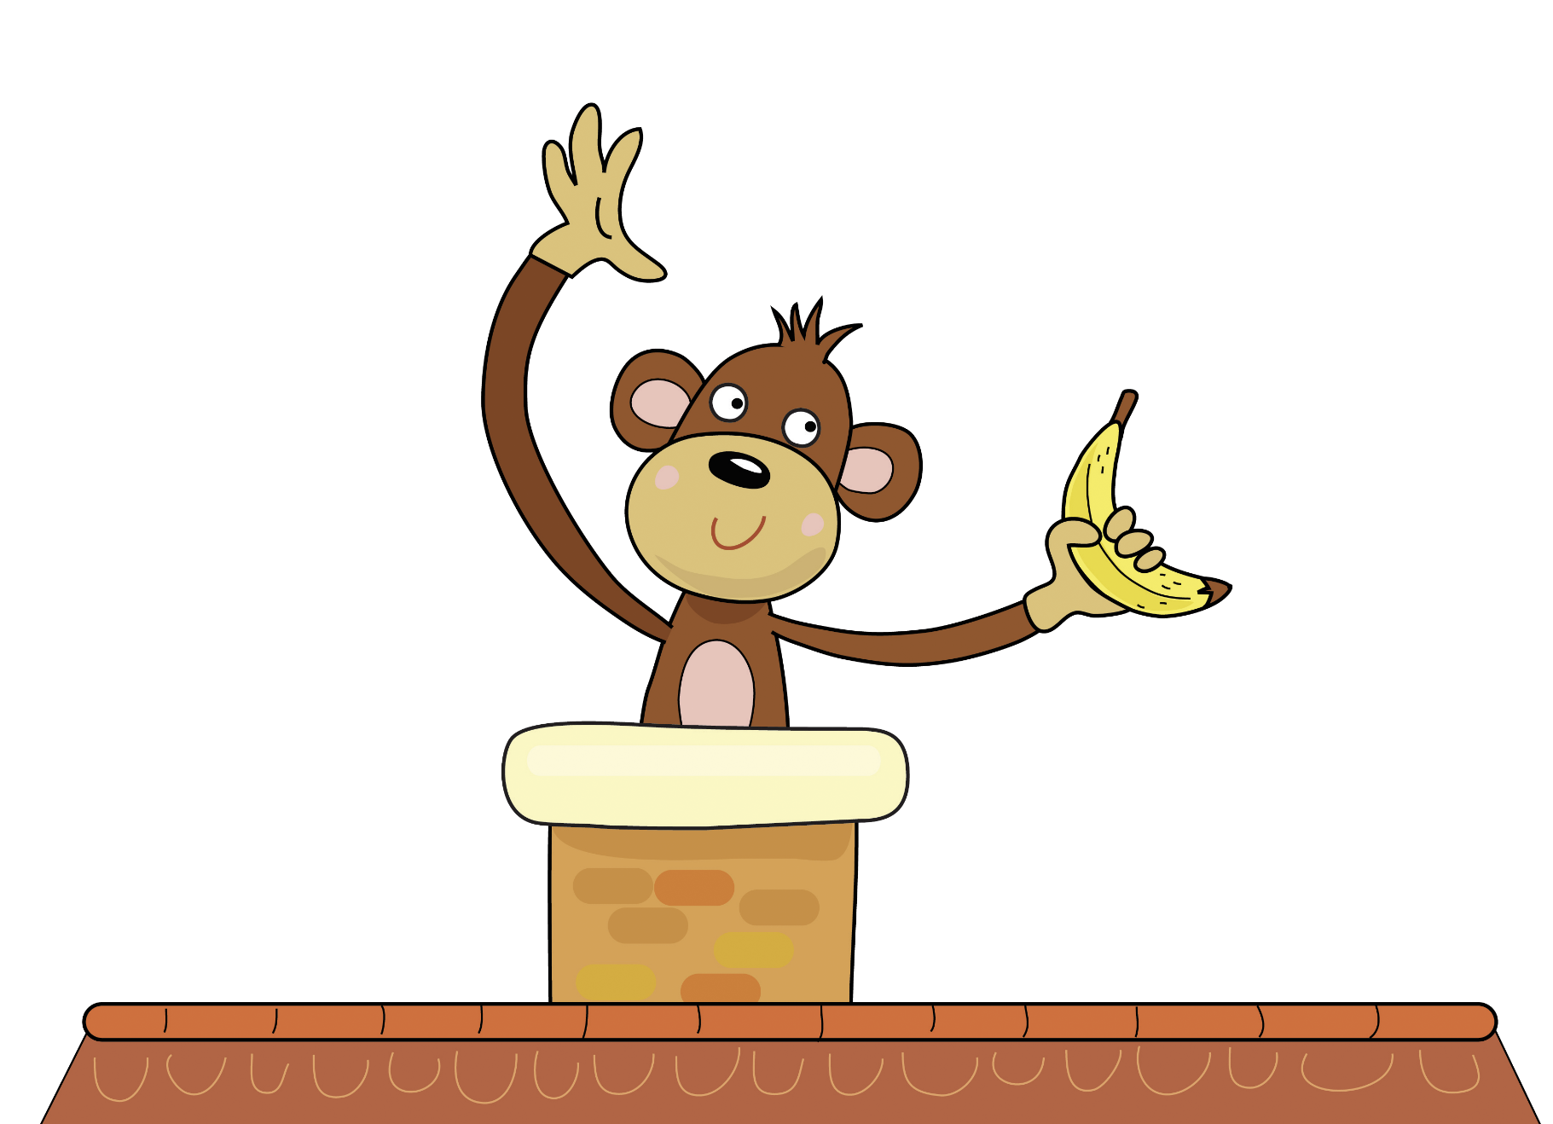
Monkey up the chimney ey ey ey

Slide 4
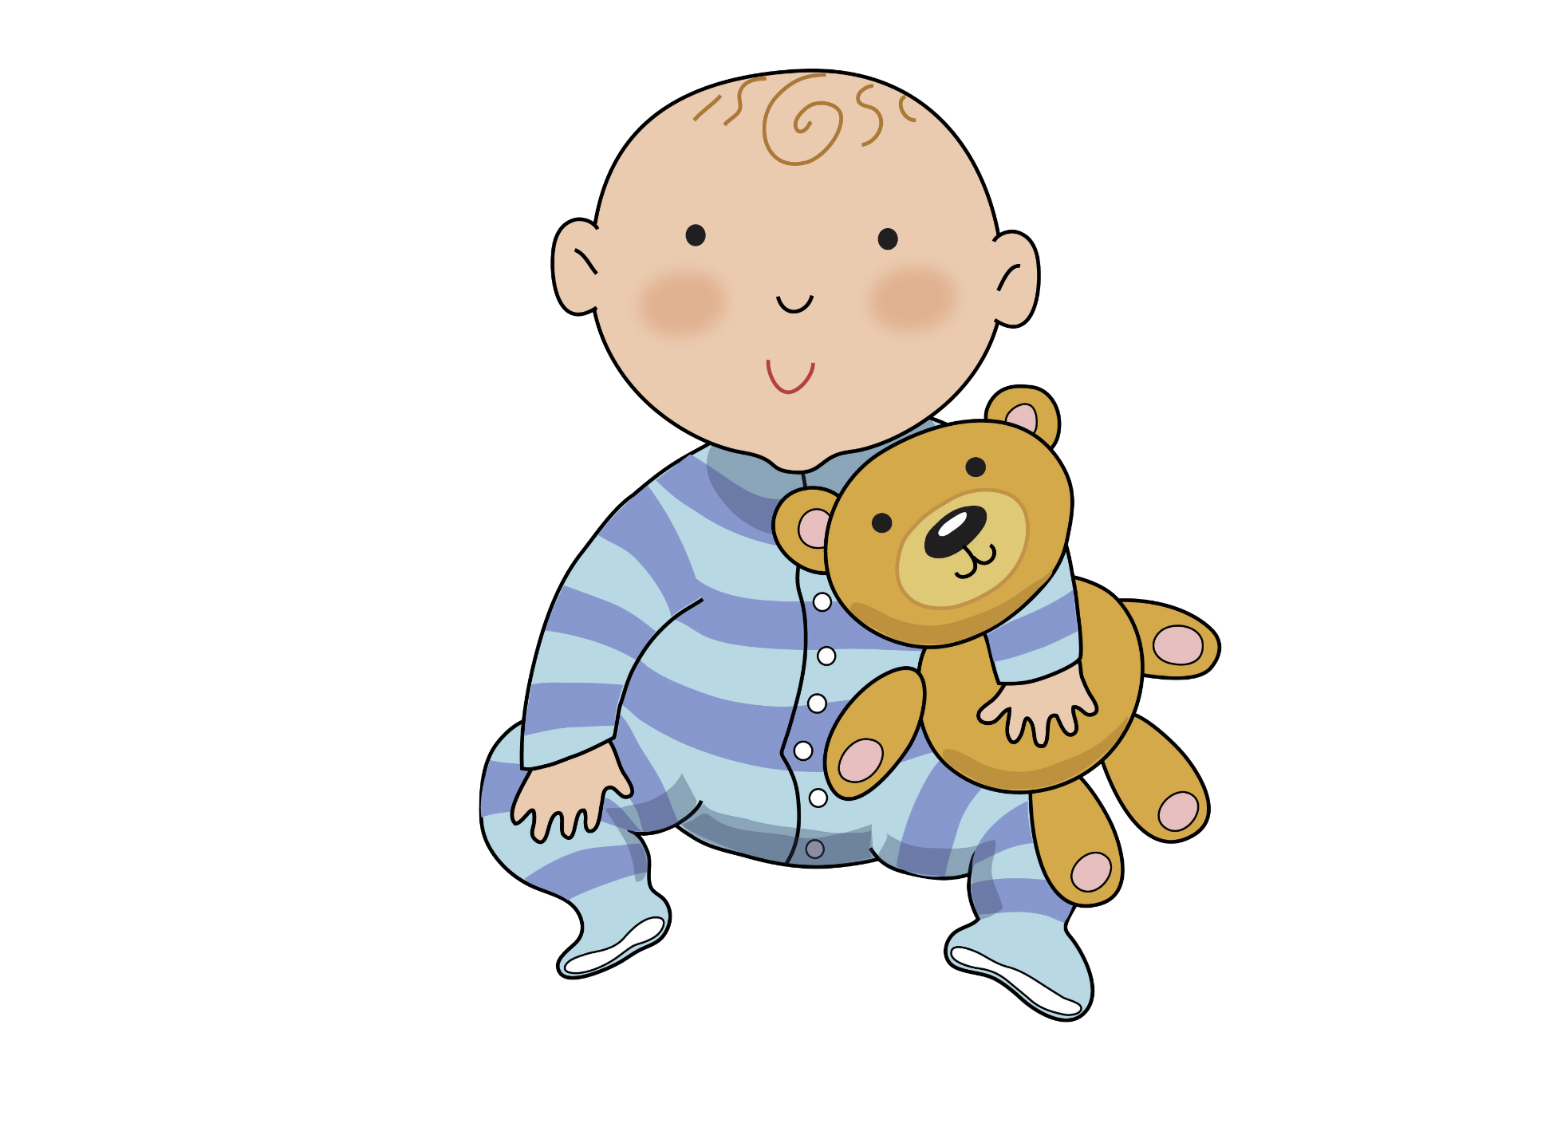
Baby with a teddy y y y

Slide 5
Believe and you’ll achieve ie ie ie

Slide 6
Skip to my lou my darling

Slide 7
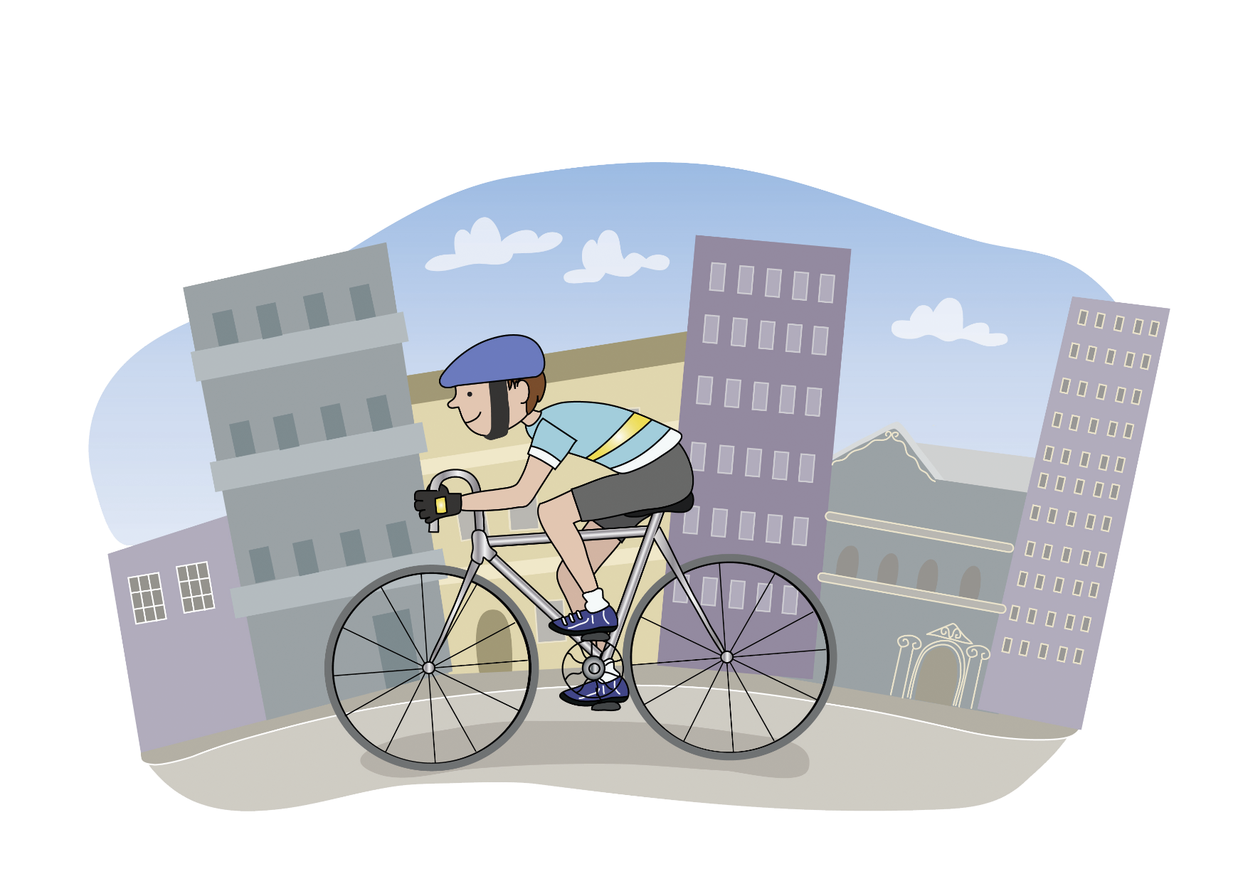
Cycle through the city c c c

Slide 8
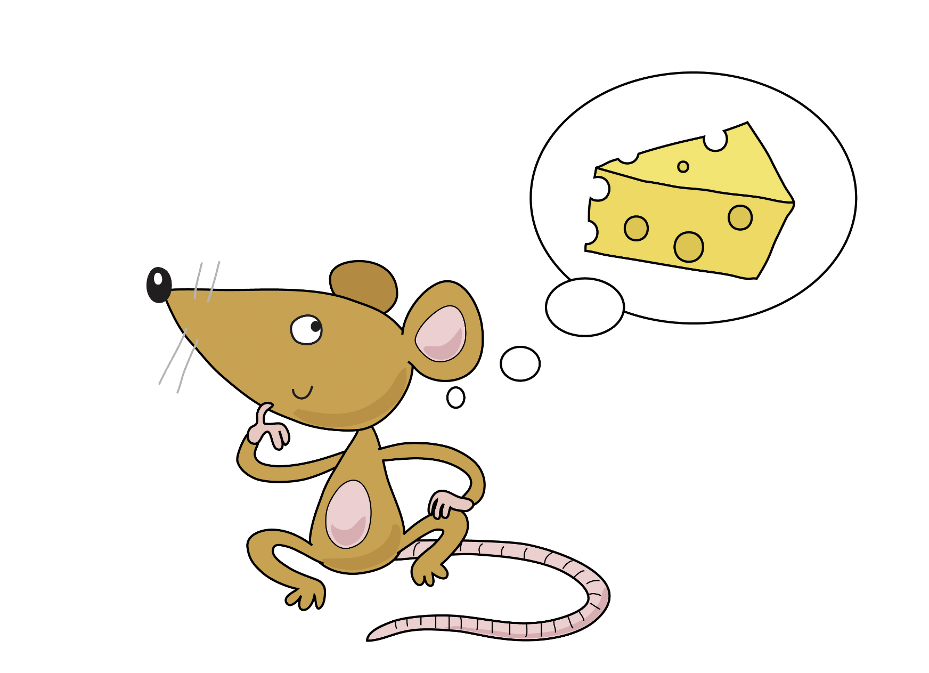
Some cheese please se se se

Slide 9
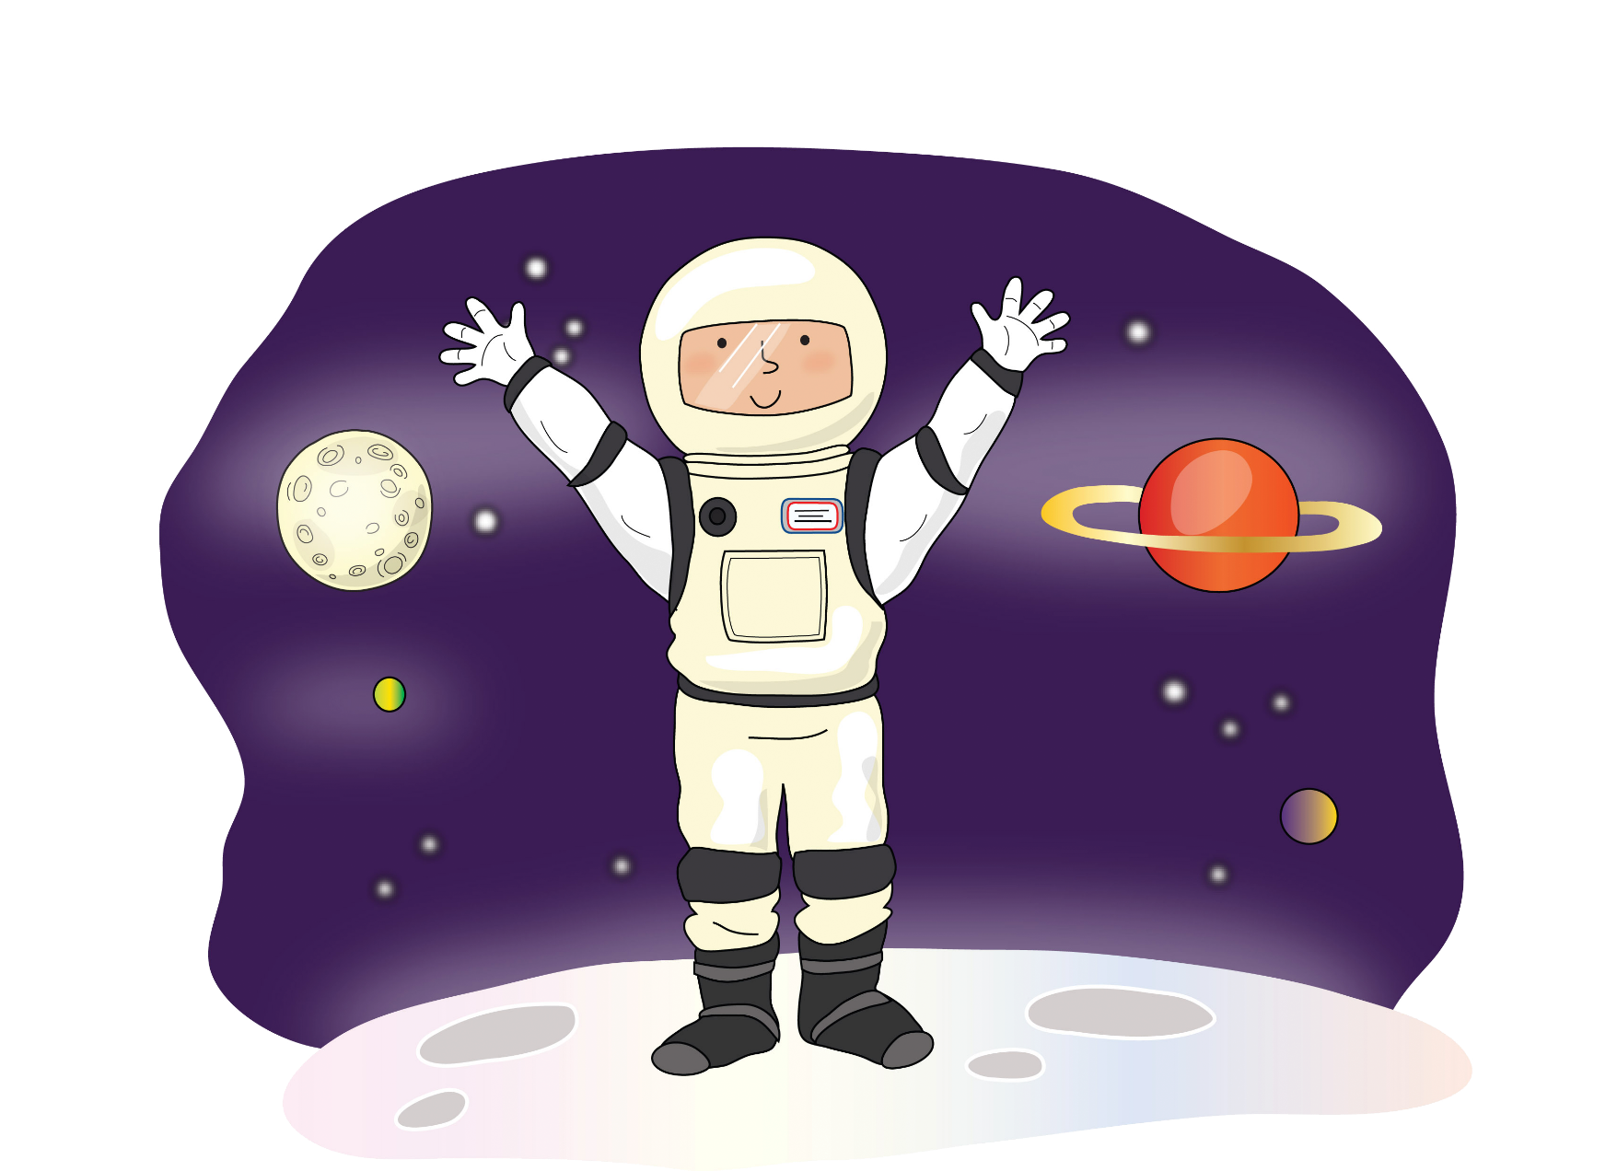
It’s ace in space ce ce ce

Slide 10
Skip to my lou my darling

Slide 11
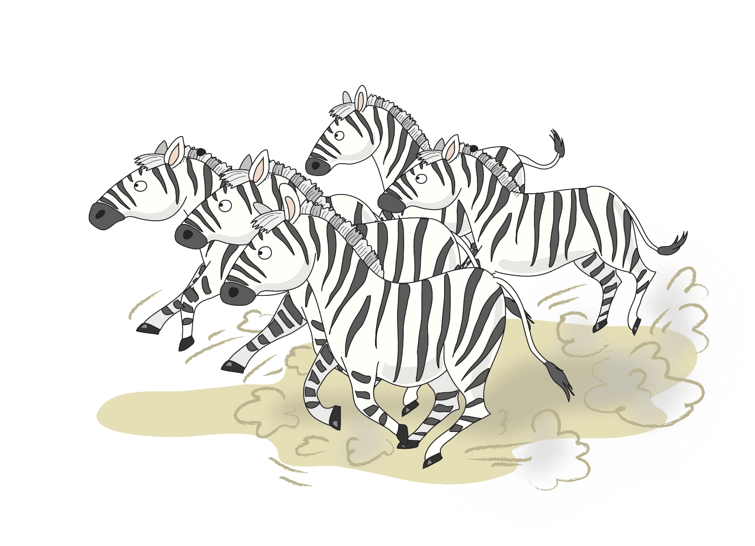
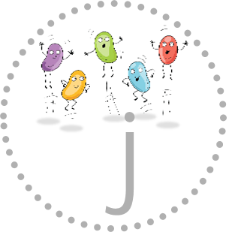
A huge charge ge ge ge

Slide 12
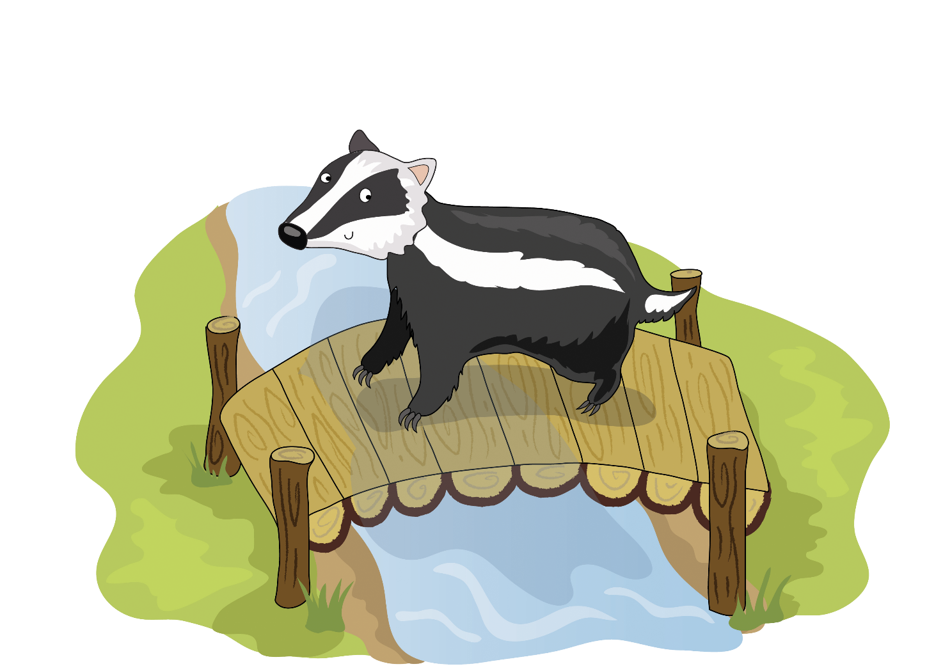
Badger on a bridge dge dge dge

Slide 13
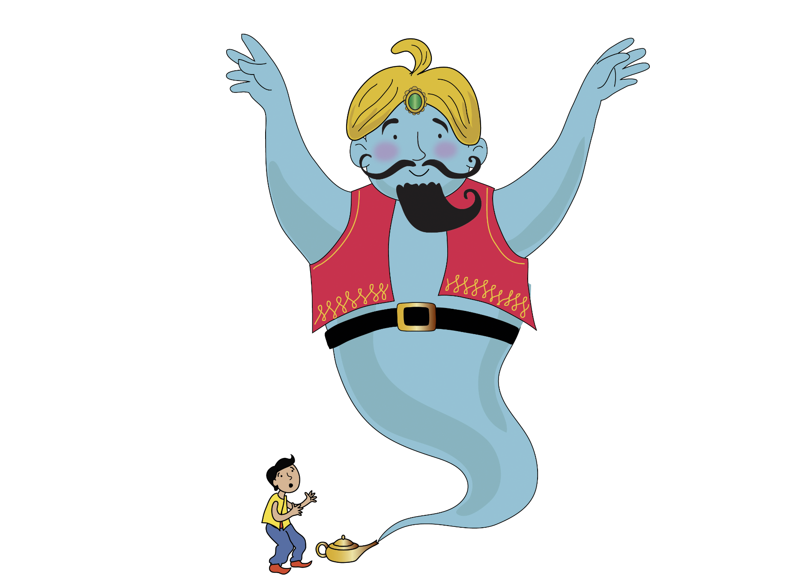
A giant genie g g g

Slide 14
Skip to my lou my darling

Slide 15
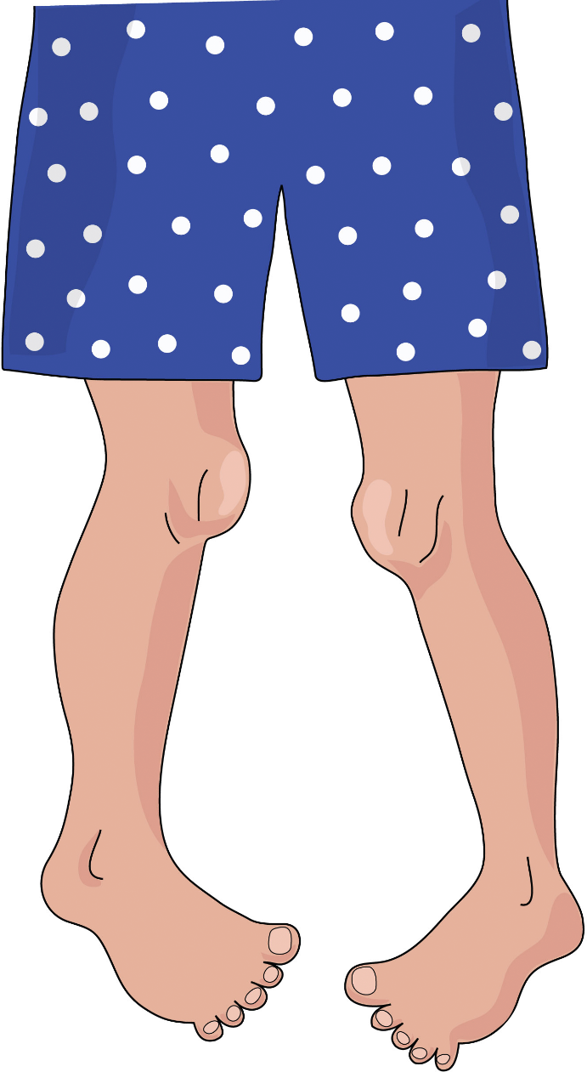
Knobbly knees kn kn kn

Slide 16
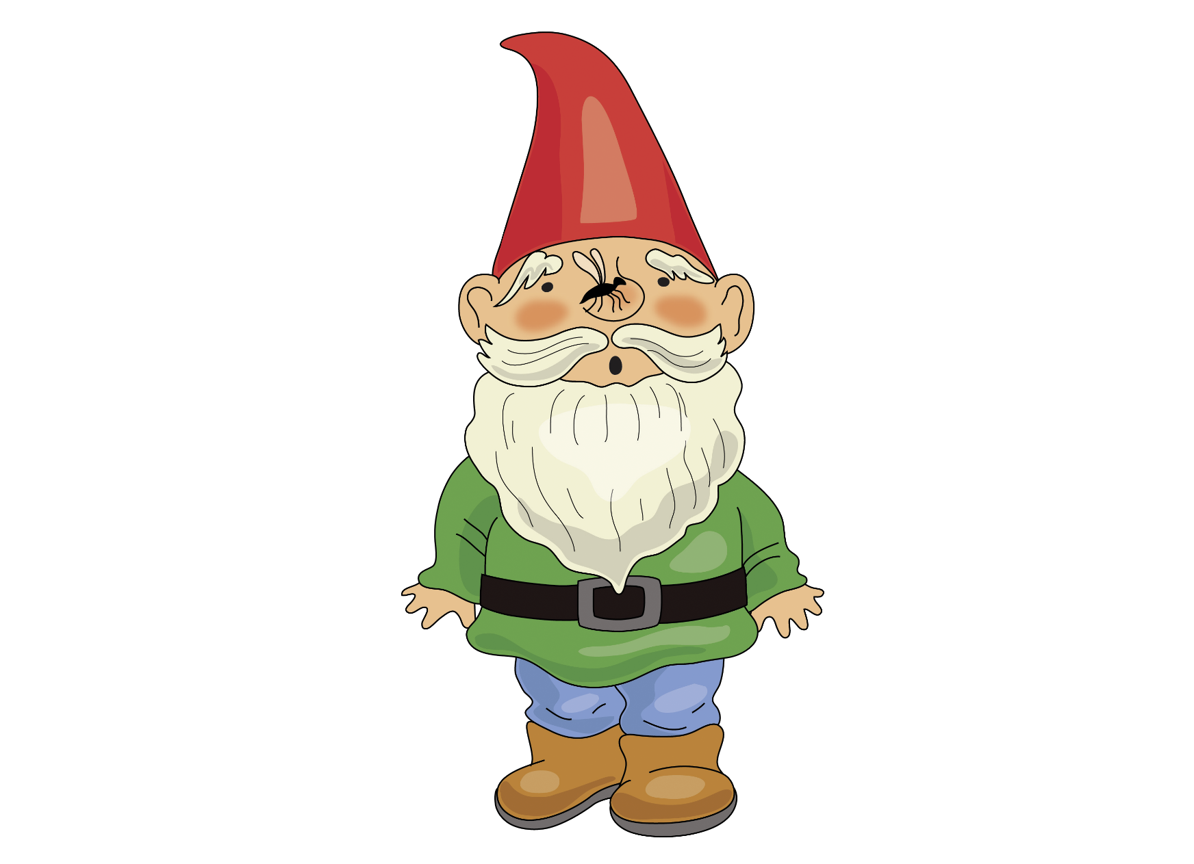
Gnat on a gnome gn gn gn

Slide 17
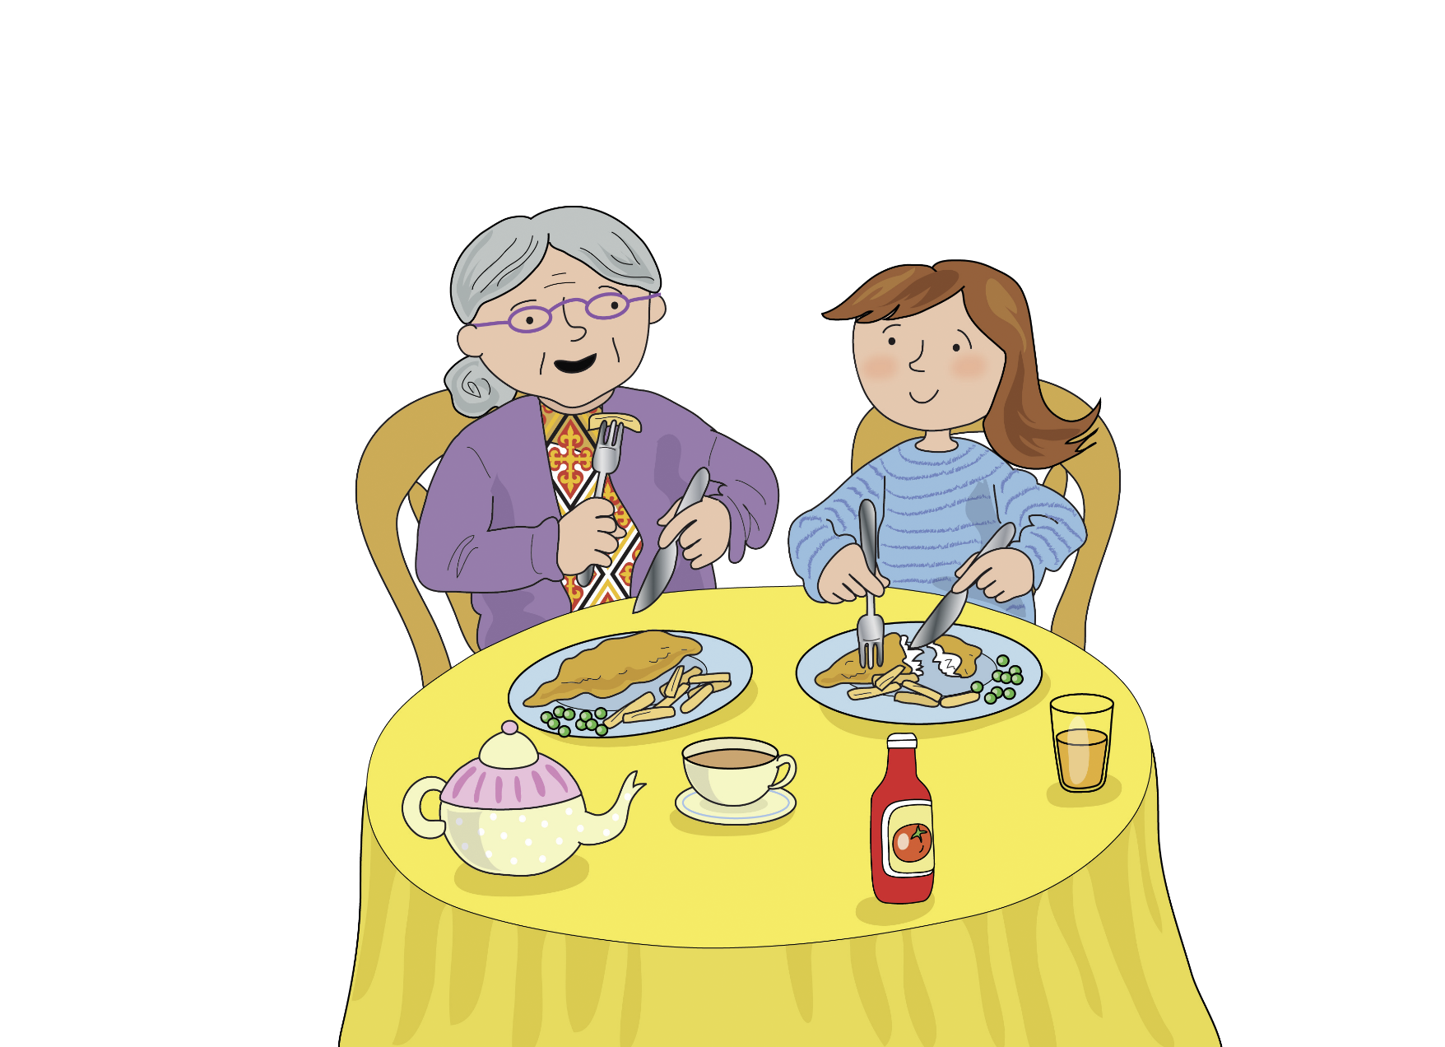
Dinner with granny nn nn nn

Slide 18
Skip to my lou my darling

Slide 19
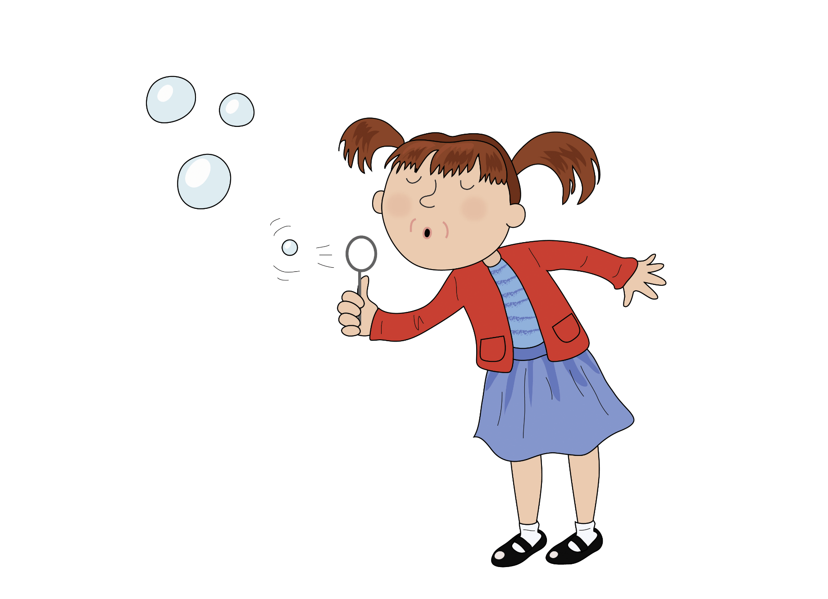
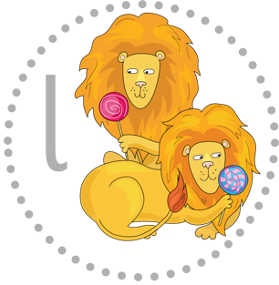
Tiny little bubble le le le

Slide 20
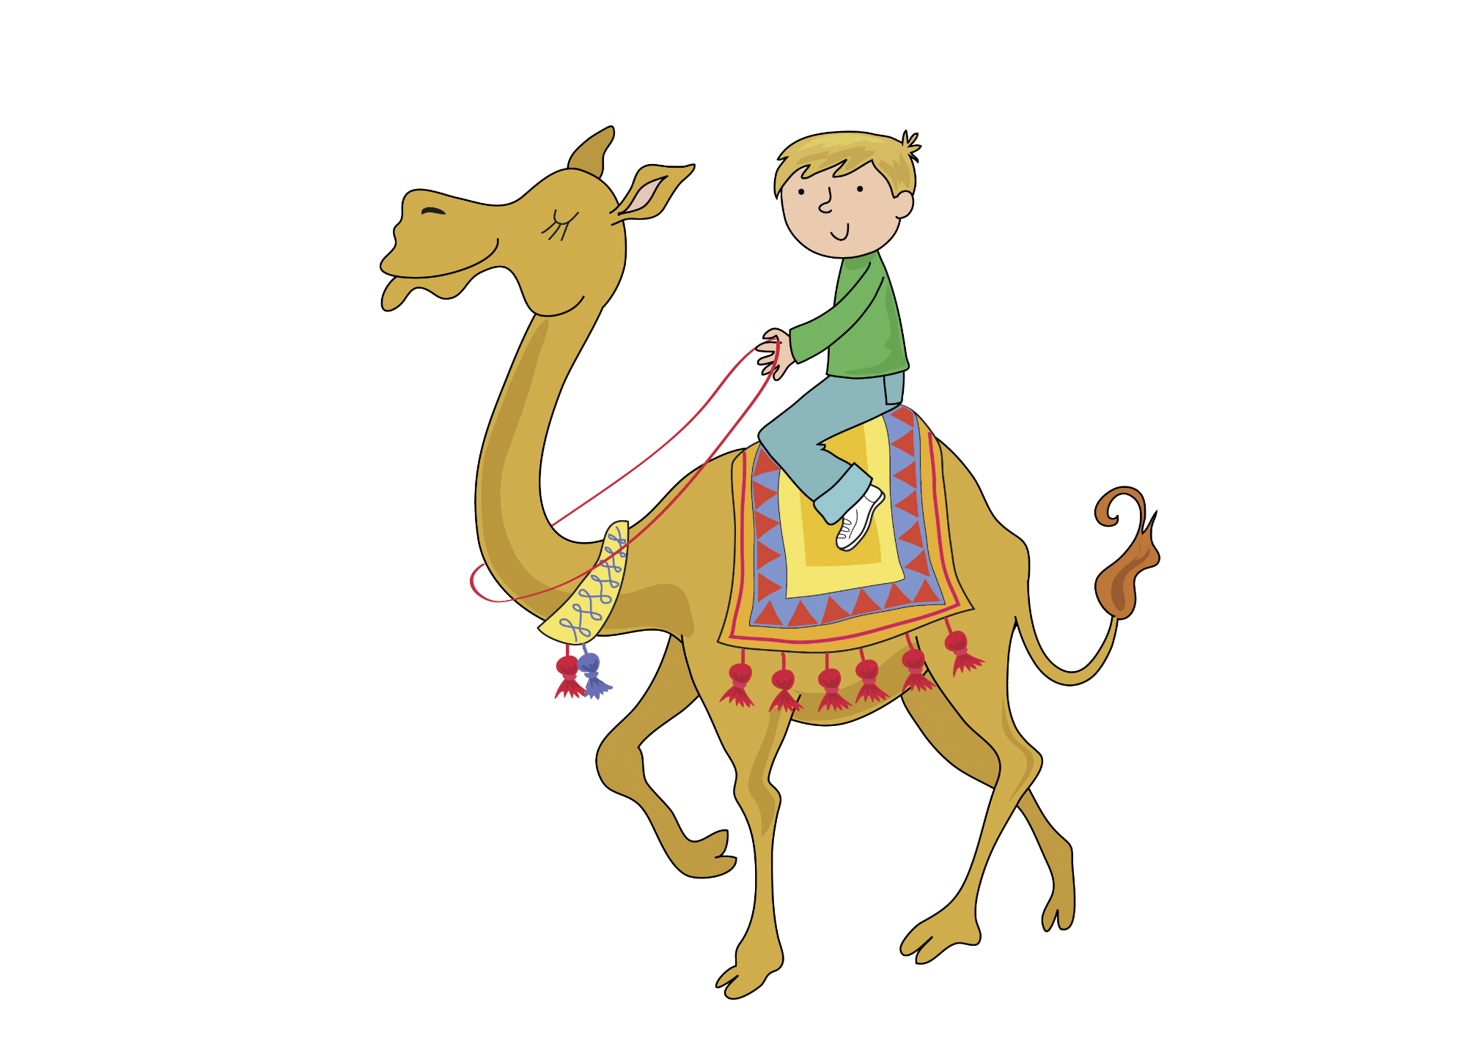
Travel on a camel el el el

Slide 21
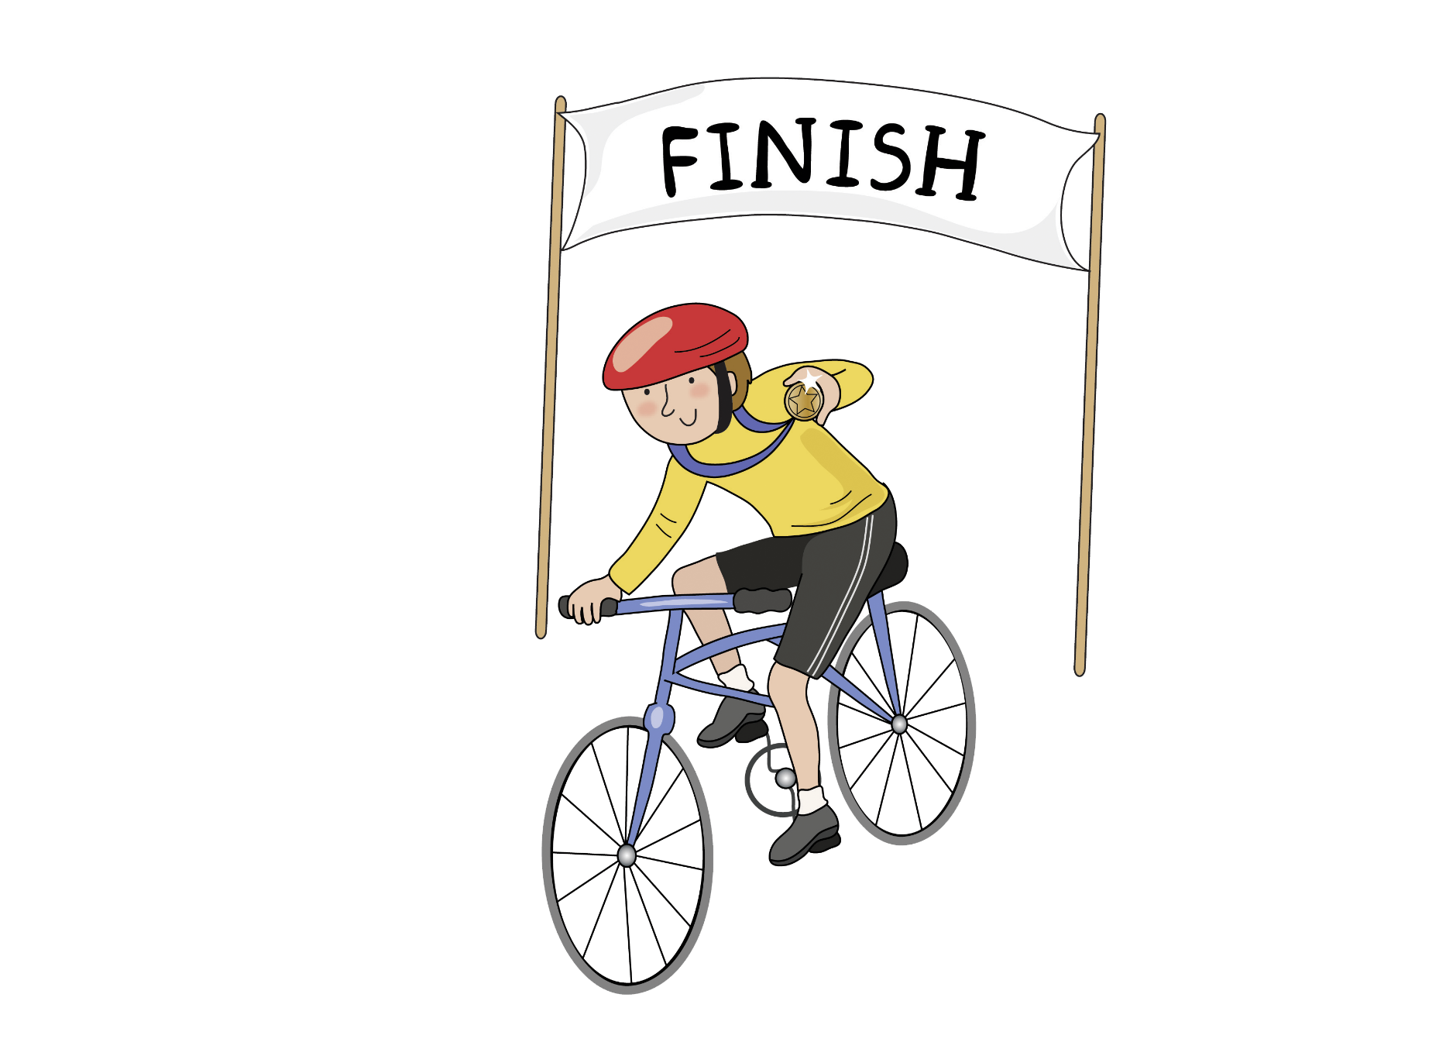
Pedal for a medal al al al

Slide 22
Skip to my lou my darling

Slide 23
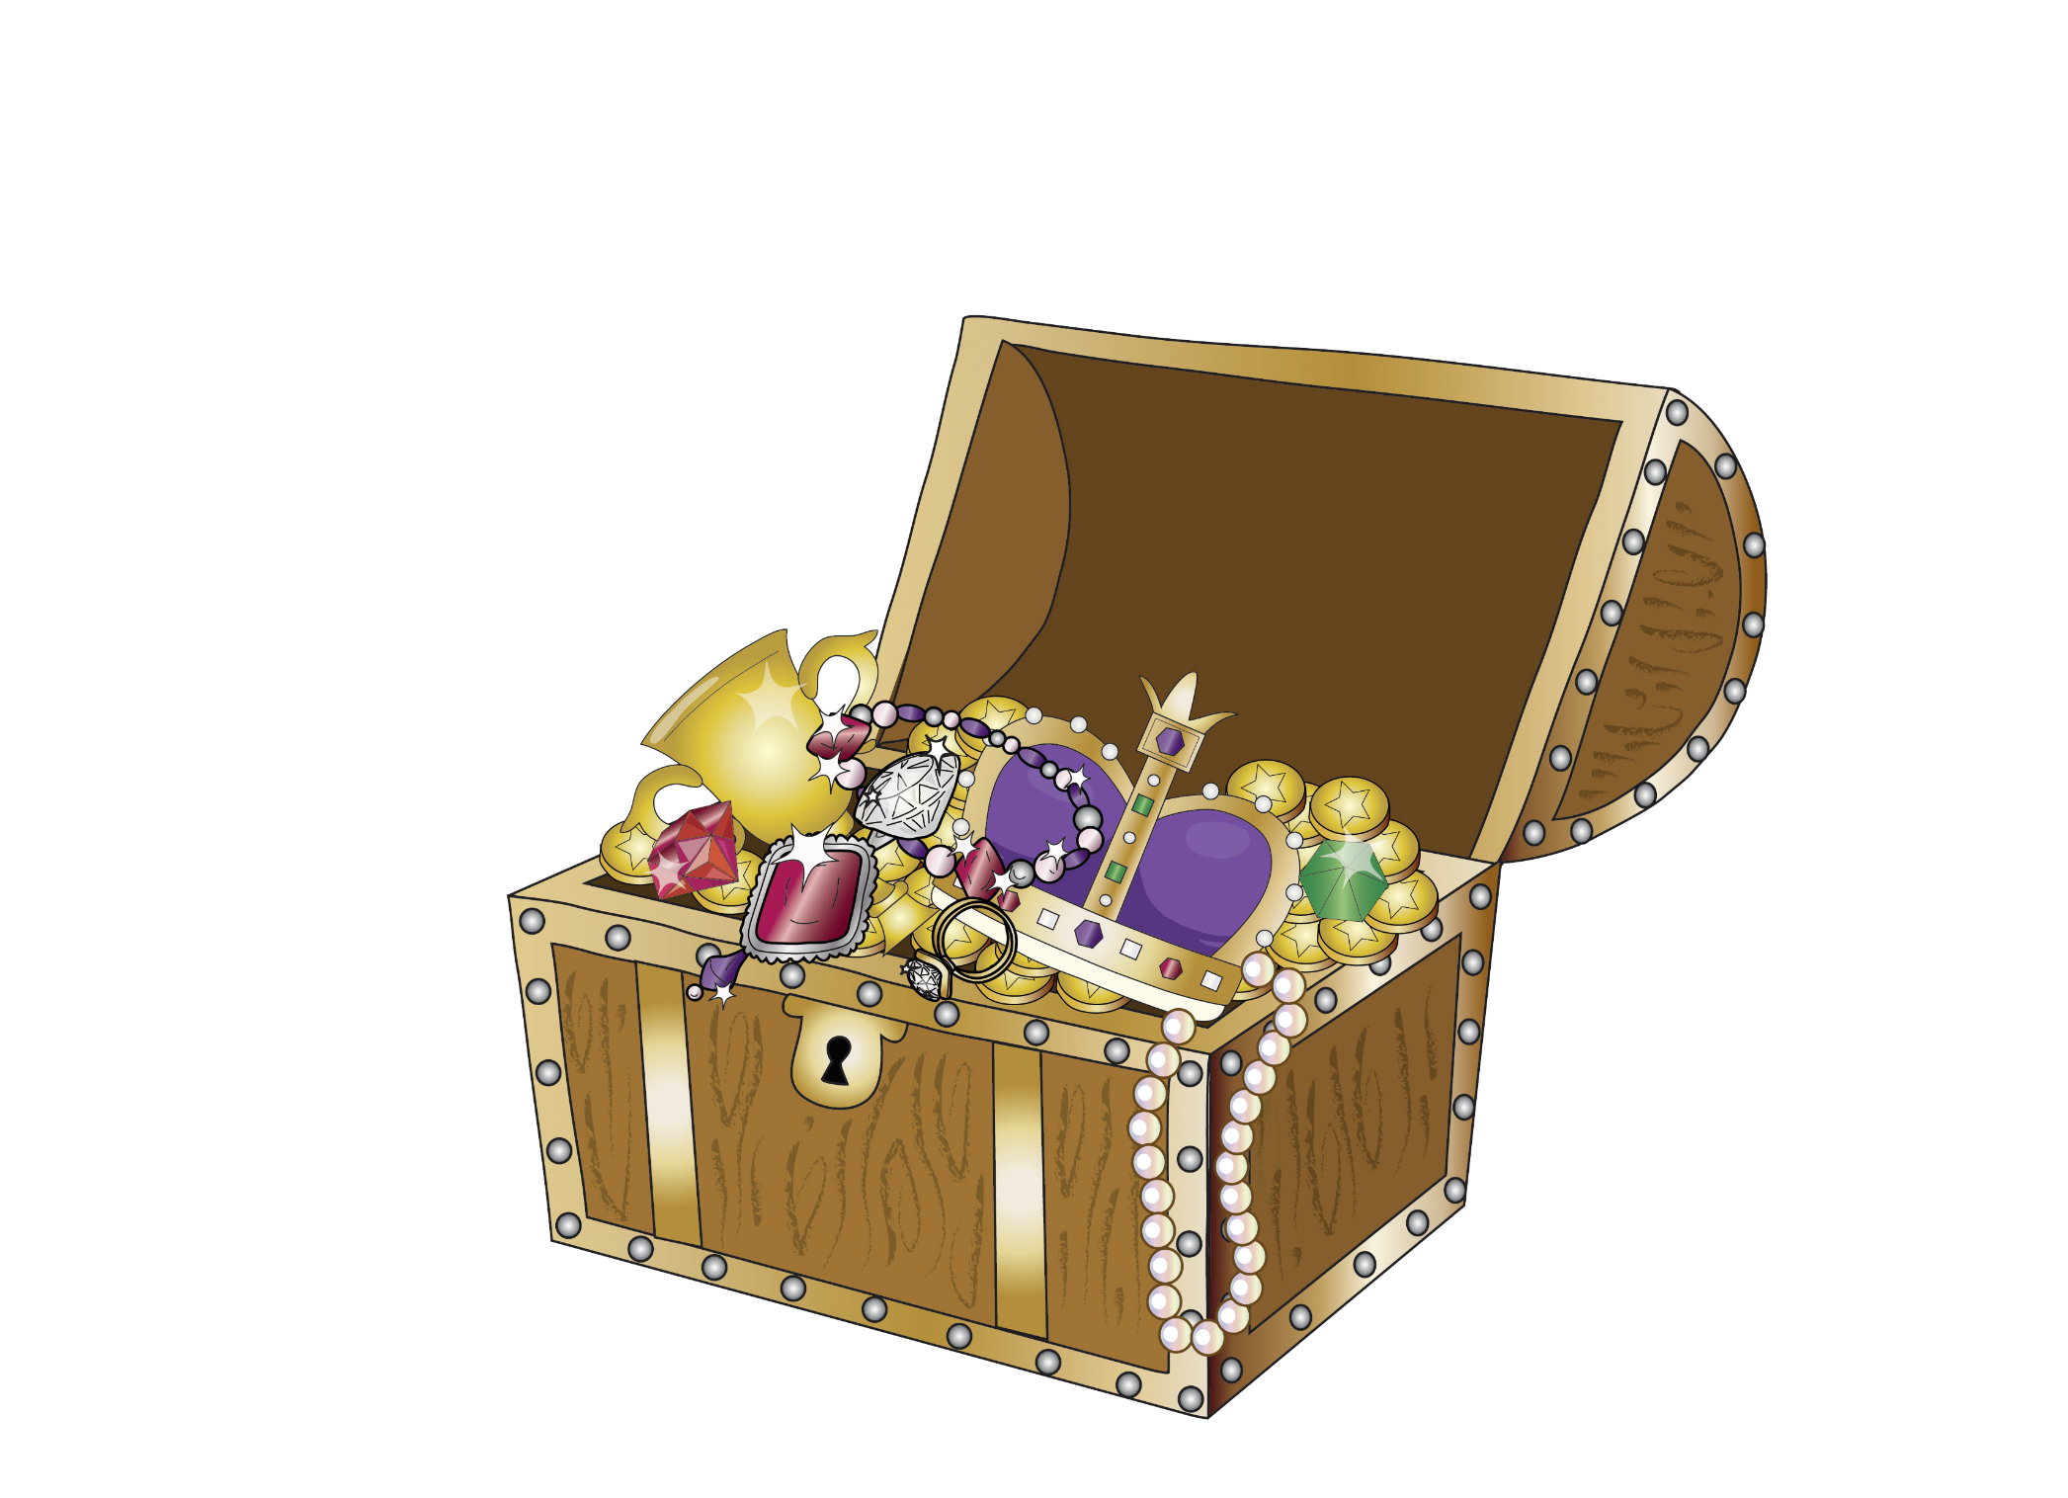
Unusual treasure s s s

Slide 24
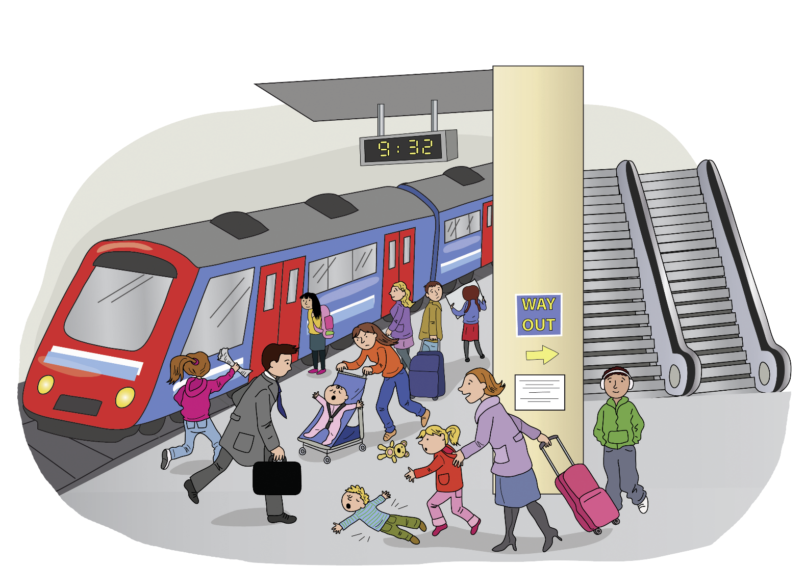
Commotion at the station ti ti ti

Slide 25
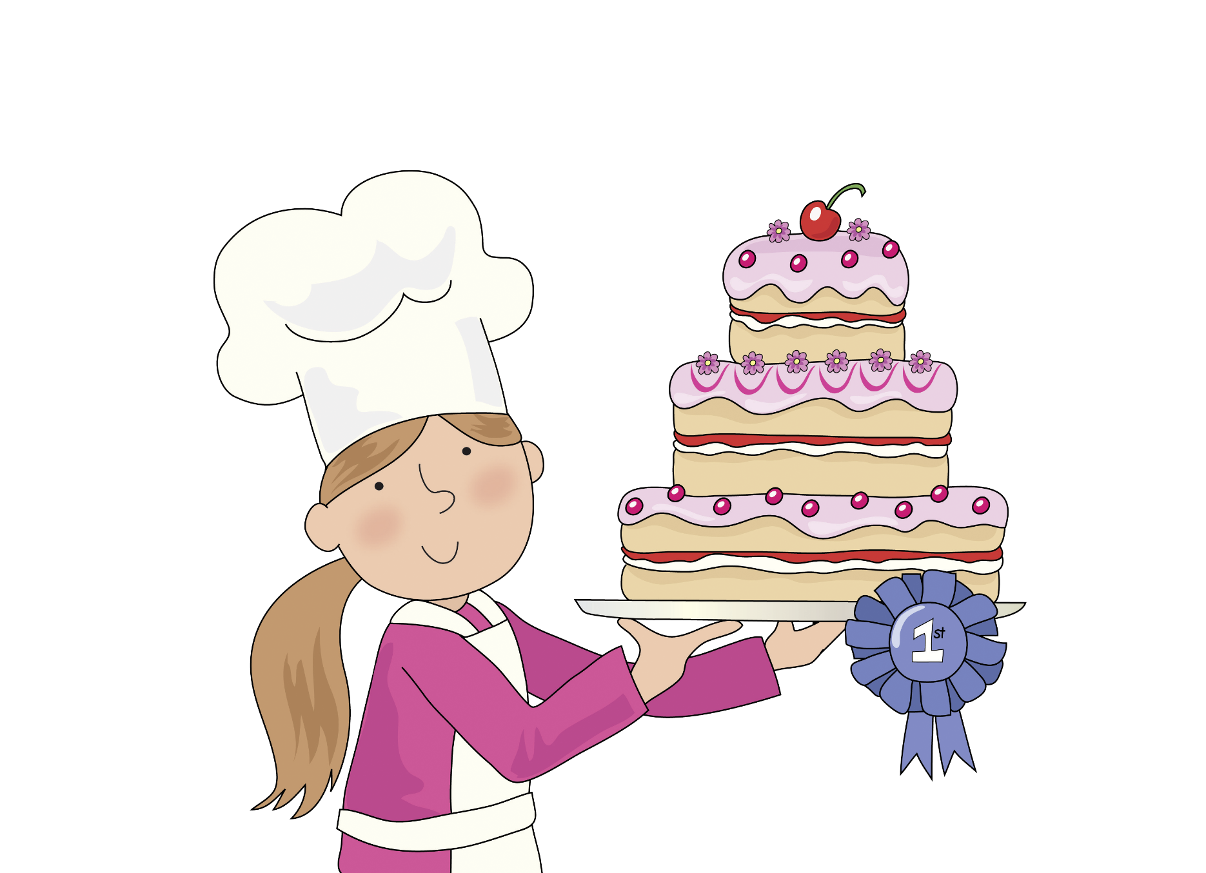
It’s officially delicious ci ci ci

Slide 26
Skip to my lou my darling

Slide 27
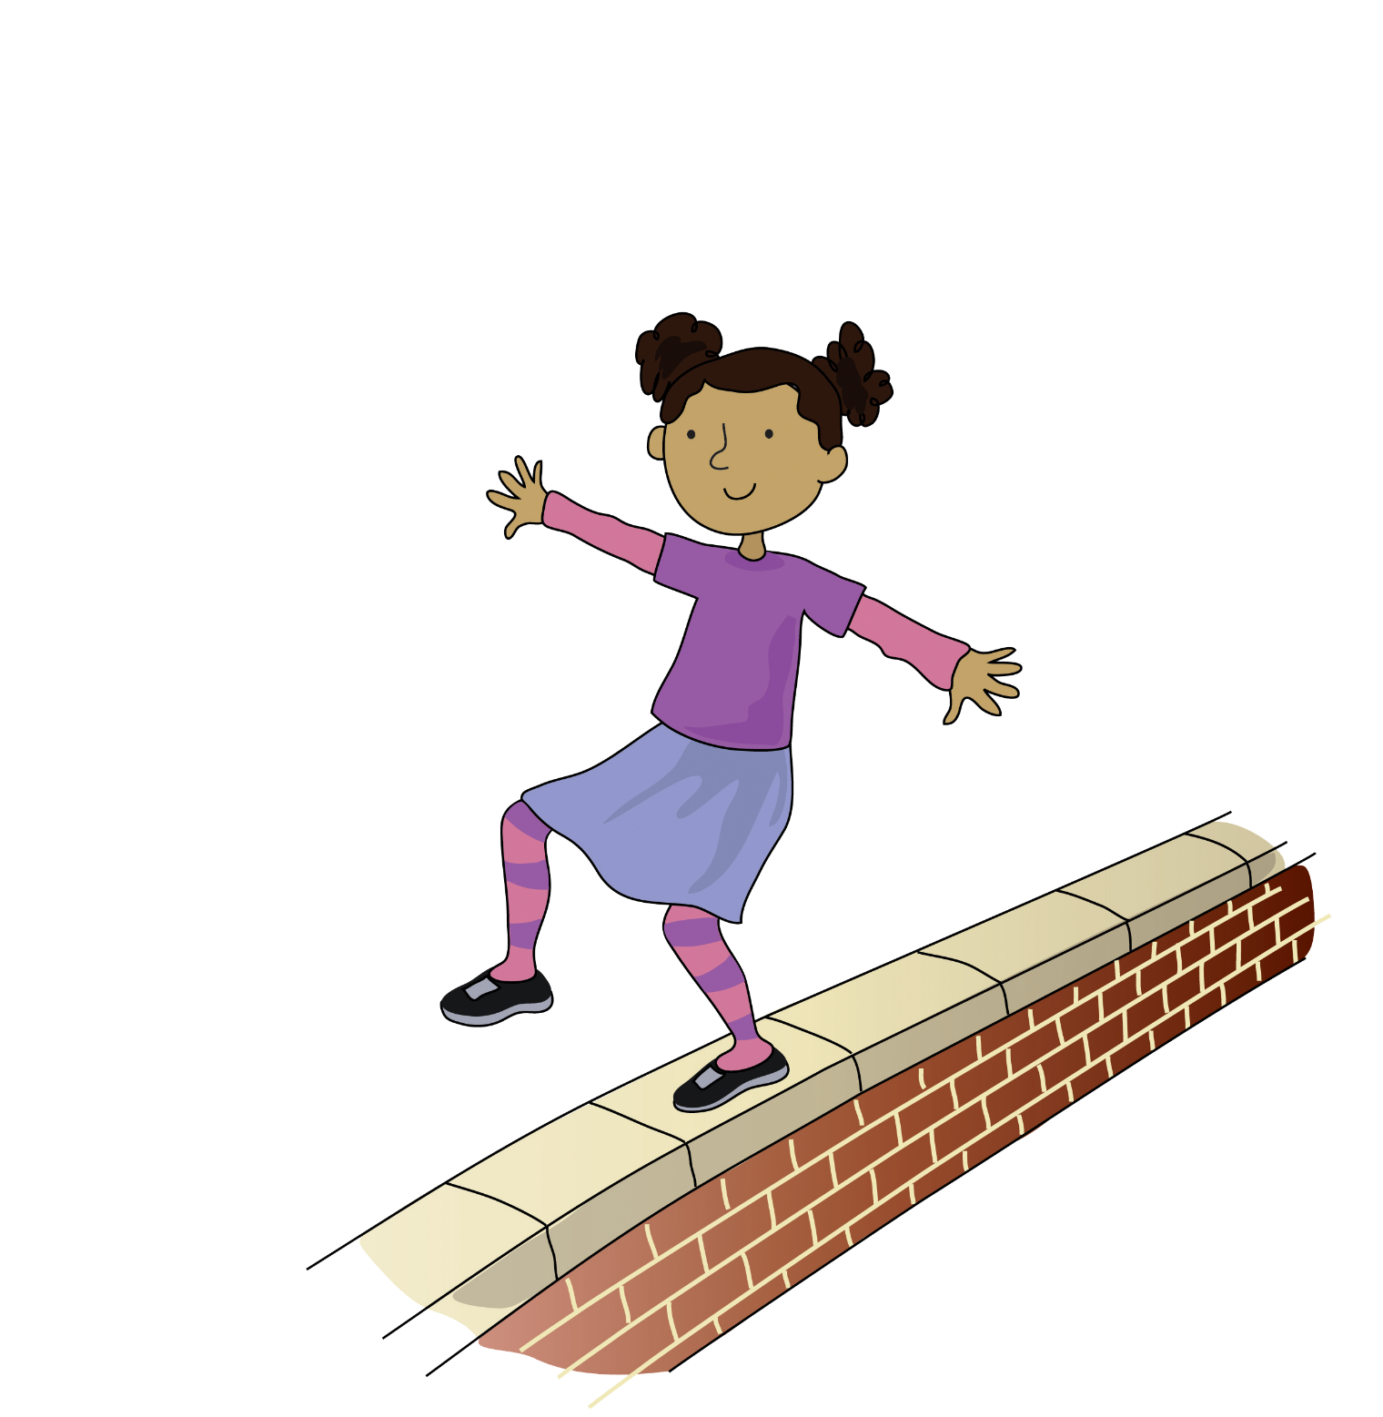
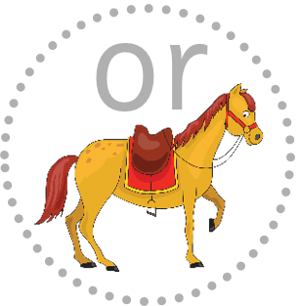
Walk along the wall a a a

Slide 28
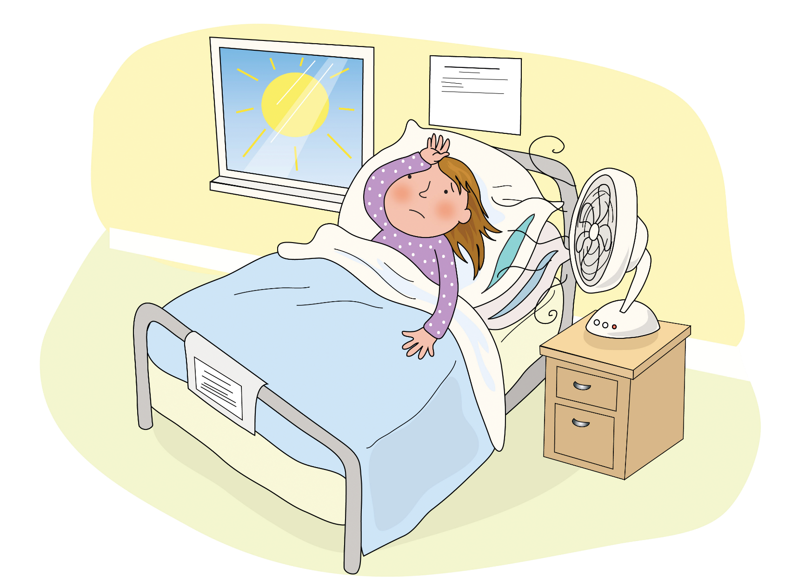
It’s warm on the ward ar ar ar

Slide 29
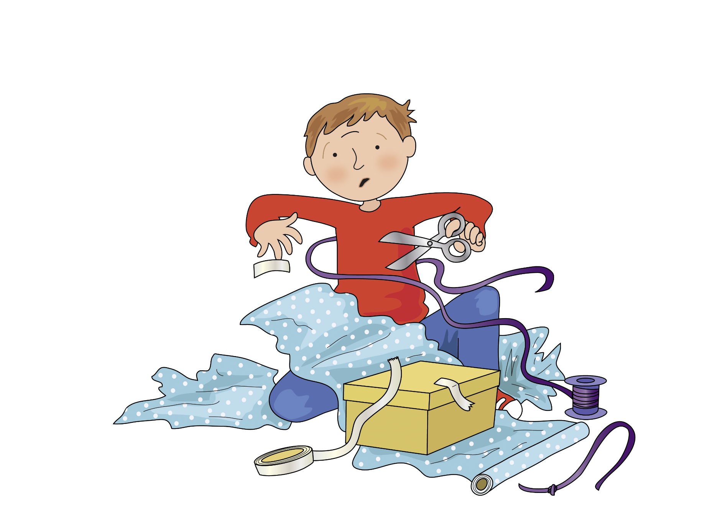
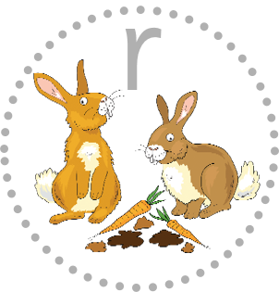
Wrestle with your wrapping wr wr wr

Slide 30
Skip to my lou my darling

Slide 31
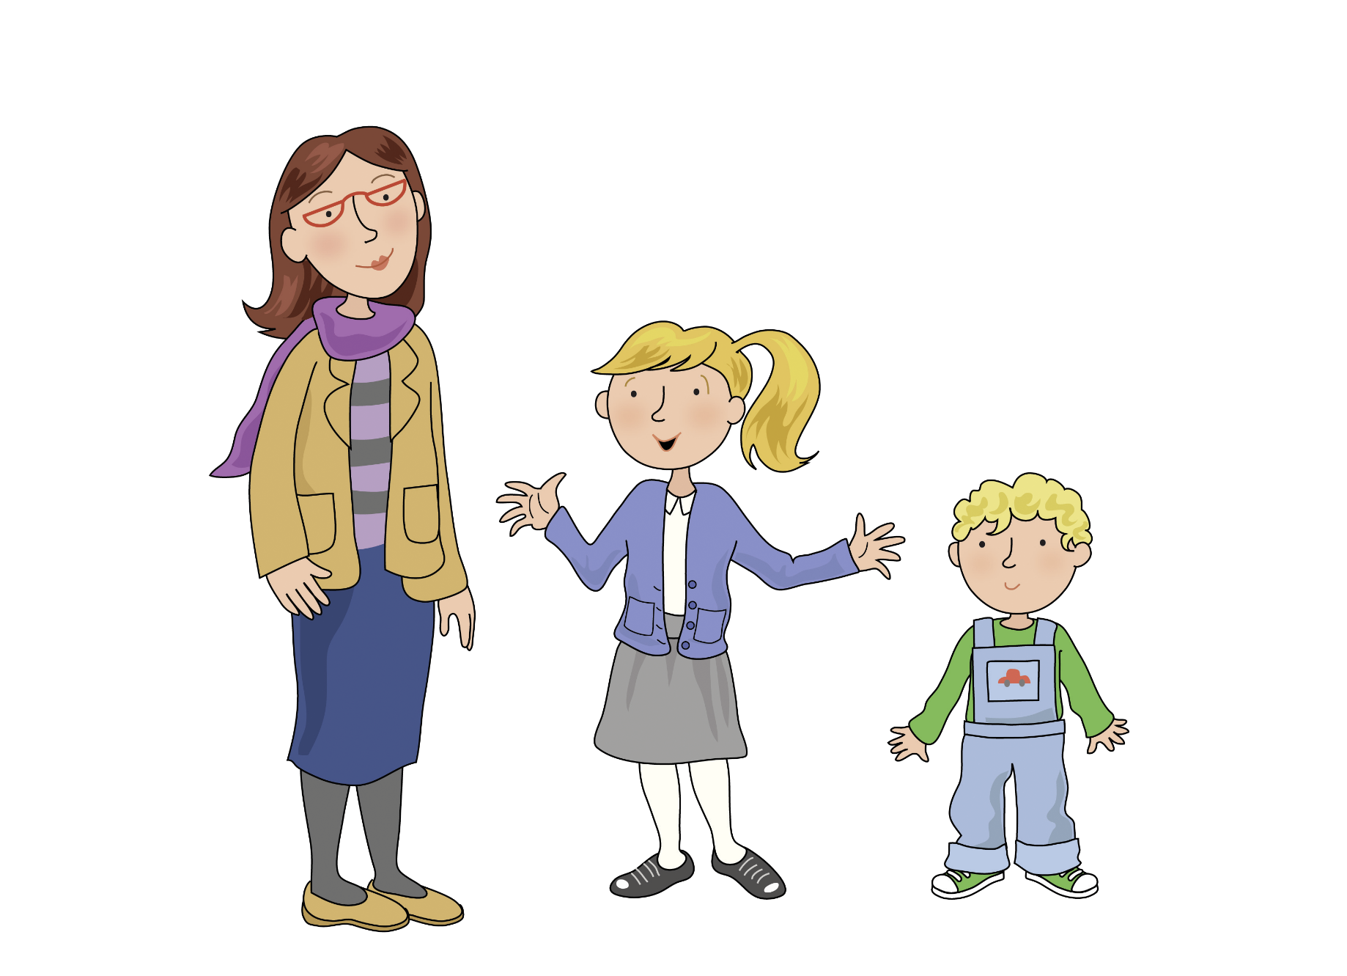
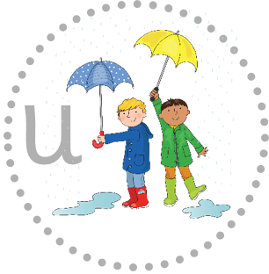
Meet my mother and my brother o o o

Slide 32
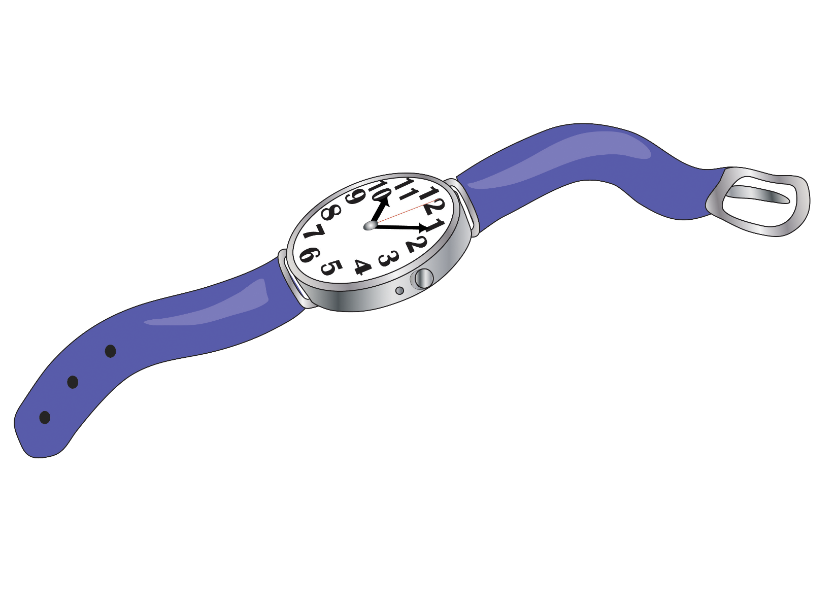
I want a new watch a a a

Slide 33
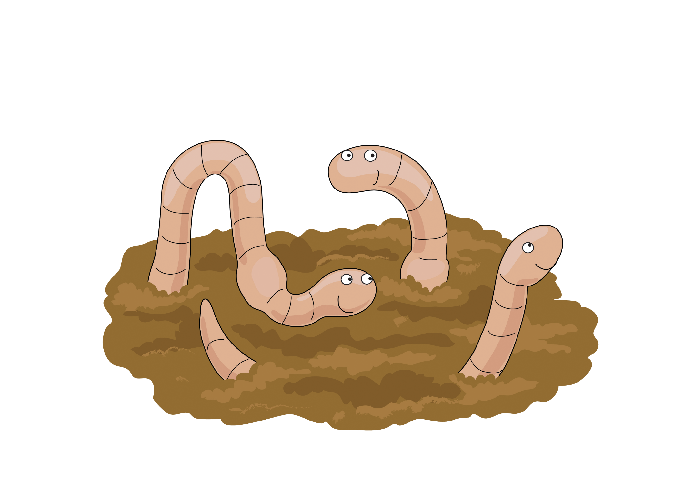
Worms at work or or or

Slide 34
Skip to my lou my darling

Slide 35
Now we’ve sung our song to you, you can learn to blend sounds too.

Slide 36
Blending helps you read and write so sing this song all day and night.

