Slide 1
How we teach your child.

Slide 2
Reading
First we want children to enjoy listening to stories and looking a pictures in books. We aim to do this every day.
Encourage the children to use story language to retell stories either from pictures or in small world play using figures, dolls, cars etc. This helps to build up their vocabulary.

Slide 3
What skills do you need to read?
Being able to focus on and manipulate sounds/phonemes – know which sound has changed if you say car and cat. Can hear rhymes.
Phonics – the sounds letters make.
Fluency – Automatic word recognition to free up headspace for comprehension.
Vocabulary – Understanding meaning.
Comprehension – Taking meaning from text.

Slide 4
Phonics
At Barrington we use a scheme called ‘Song of Sounds’.
We have a phonics lesson every day for 20 minutes.
4 new phonemes are introduced each week. We look at the name and sound of the letter. Think of words which might start with that sound and we learn the song and action which goes with the letter. We also look at the formation and that is our handwriting for the week.
Every day we recap all of the phonemes learned so far and we add the new one.
We have games which might be played on screen, played outside or in the classroom.
(play week 4 software, last slide on week 8 into digraph bar)

Slide 5
Sound buttons – individual sounds where there is only 1 letter eg a
Sound bar – a bar indicates a digraph where there is 1 sound but 2 or 3 letters eg ai

Slide 6
Tricky words
These are the words which children cannot work out using their phonetic knowledge.
We have 2 or 3 which we concentrate on every week. We practice reading and writing them everyday.

Slide 7
Now that the children all have a bank of tricky words and phonemes which they know, they are all starting to read.
They also use pictures and context clues to help work out what the text says.
Encourage them to point and follow the words with their finger.
Ask them about what they have read and what they think about events, the setting and the characters.

Slide 8
When to read!

Slide 9
My phoneme and tricky word record book.

Slide 10
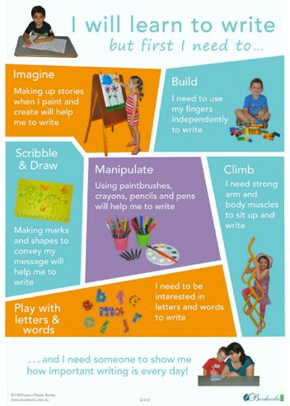
Writing
When we read we need blending skills.
When we write we need segmenting skills and remember what phonemes look like. We robot talk!
We also need to start writing tricky words.

